Slide 1

Modernizing IT with HCI
Mark Perry- Sr. Systems Engineer

Slide 2


Nutanix Customer Journey
Multi-Cloud Services for Apps and Data
  Unify operations across public and private clouds
Build an Enterprise Cloud
  Secure and automate applications, and consolidate storage
Modernize IT with HCI
  Deliver enterprise apps and VDI from any site

Slide 3
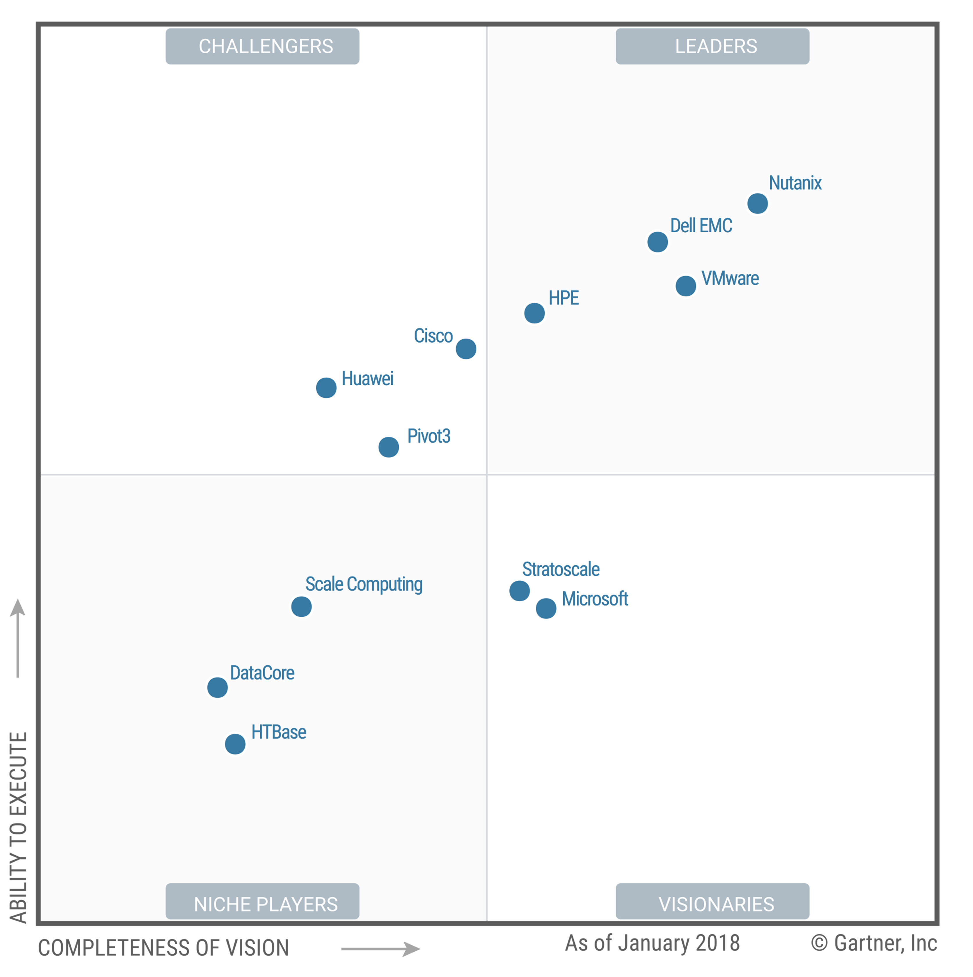
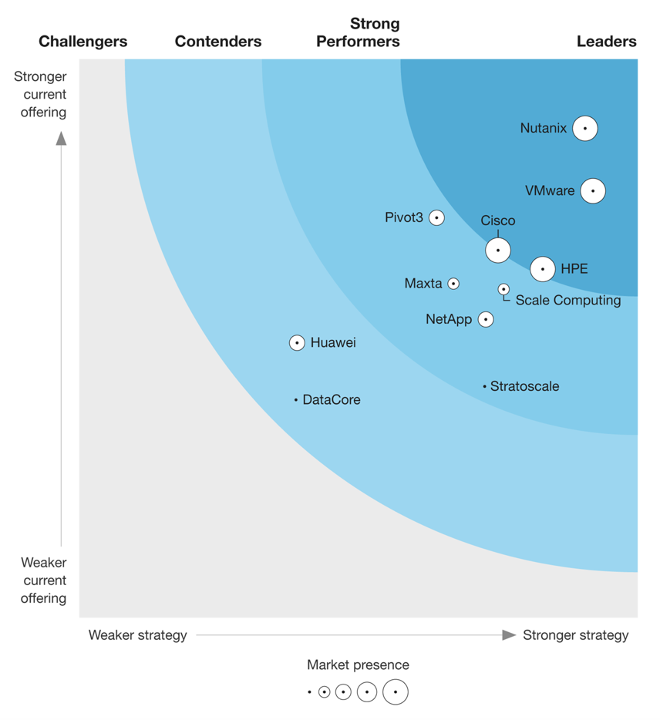
Undisputed Leader
Challengers
Leaders
Niche Players
Visionaries
Gartner Magic Quadrant for HCI, 2018
The Forrester Wave
Hyper-Converged
Infrastructure, 2018
IDC’s Competitive Landscape of HCI Software Only, 2018

Slide 4








IT Complexity Is Hurting Business
Buy
Scale
Deploy
Upgrade
Manage
Troubleshoot
Infrastructure
Process
People
Time consuming to provision
Multiple points of failure
Difficult to scale and upgrade
Large upfront CapEx
Little time for
innovation
Requires IT specialists
Notes:
Today, IT leaders struggle to manage the unrelenting complexity across their IT environments. This includes not only core datacenter infrastructure, but remote and branch offices, disaster recovery sites and more. This complexity makes it difficult for the business to pursue new markets, develop advanced products & services, and tackle strategic initiatives, such as digital transformation projects.
Much of the challenge stems from legacy infrastructure, constructed with discrete resource silos, such as storage, server, virtualization, networking and security. This fragmented design makes it difficult and time consuming to provision new IT environments to run critical business applications. Additionally, these architectures have multiple points of failure, creating a fragile IT system that is susceptible to unplanned downtime.
Managing this IT complexity demands significant process overhead for executing even basic tasks, such as adding additional capacity or upgrading software – adding unwanted friction to IT operations and slowing the business. Legacy architectures also impose financial burdens, with large upfront capital purchases required even for small-scale deployments.
This undeniable complexity has a profound impact on already-stretched IT teams. It requires the tight coordination of multiple IT specialists to handle simple operations, and – most importantly – leaves little time for true innovation.

Slide 5
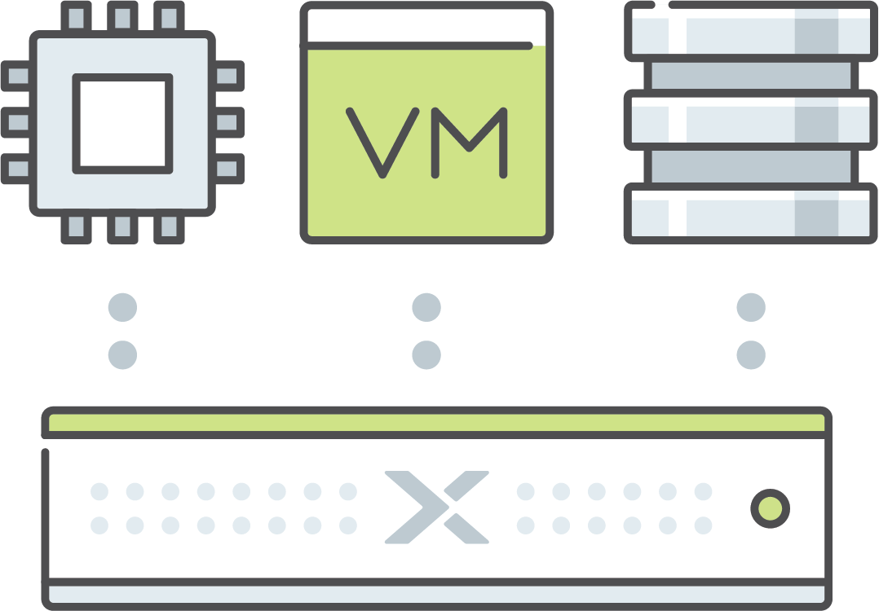
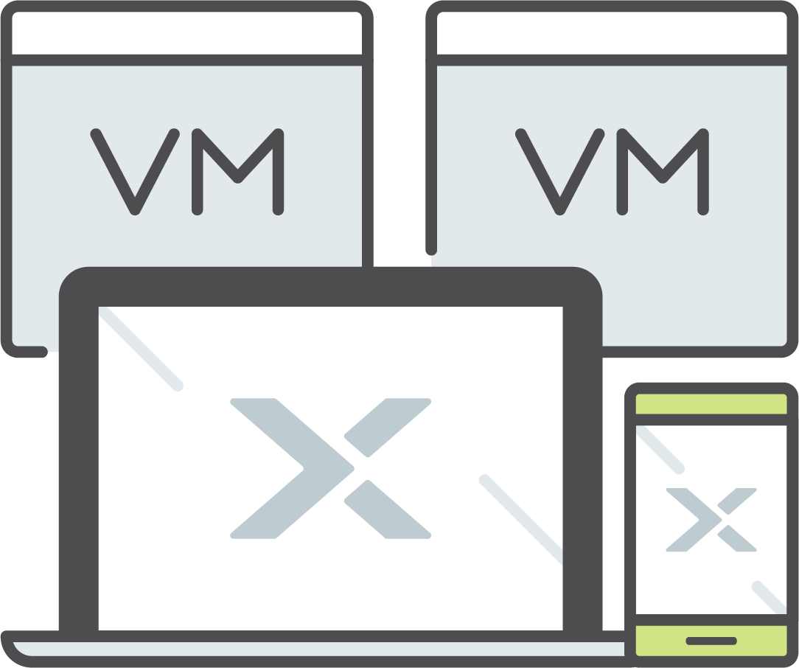

Slows Application Delivery
Enterprise Applications
Virtual Desktops
Remote & Branch Offices
  Different workload characteristics
  Varied availability demands
  Demands agile rollout, upgrades and expansion
  Scaling is difficult
  Inconsistent user experience
  Multiple layers to manage
  Islands of infrastructure increase administration demands
  Lack of local IT expertise
  Need reliable data protection and security

Slide 6
Bring the Cloud Inside
You Get:
Rapid Time to Market
Pay-as-you-Grow
One-Click Operations
Continuous Innovation
Software-defined Everything
Machine Learning Automation
Self-healing Systems
Web-scale
Engineering
Off-the-Shelf Hardware
No Single Point of Failure
Built for Hybrid
Notes:
Move sd to the top
No web scale in the slide --- need it

Slide 7

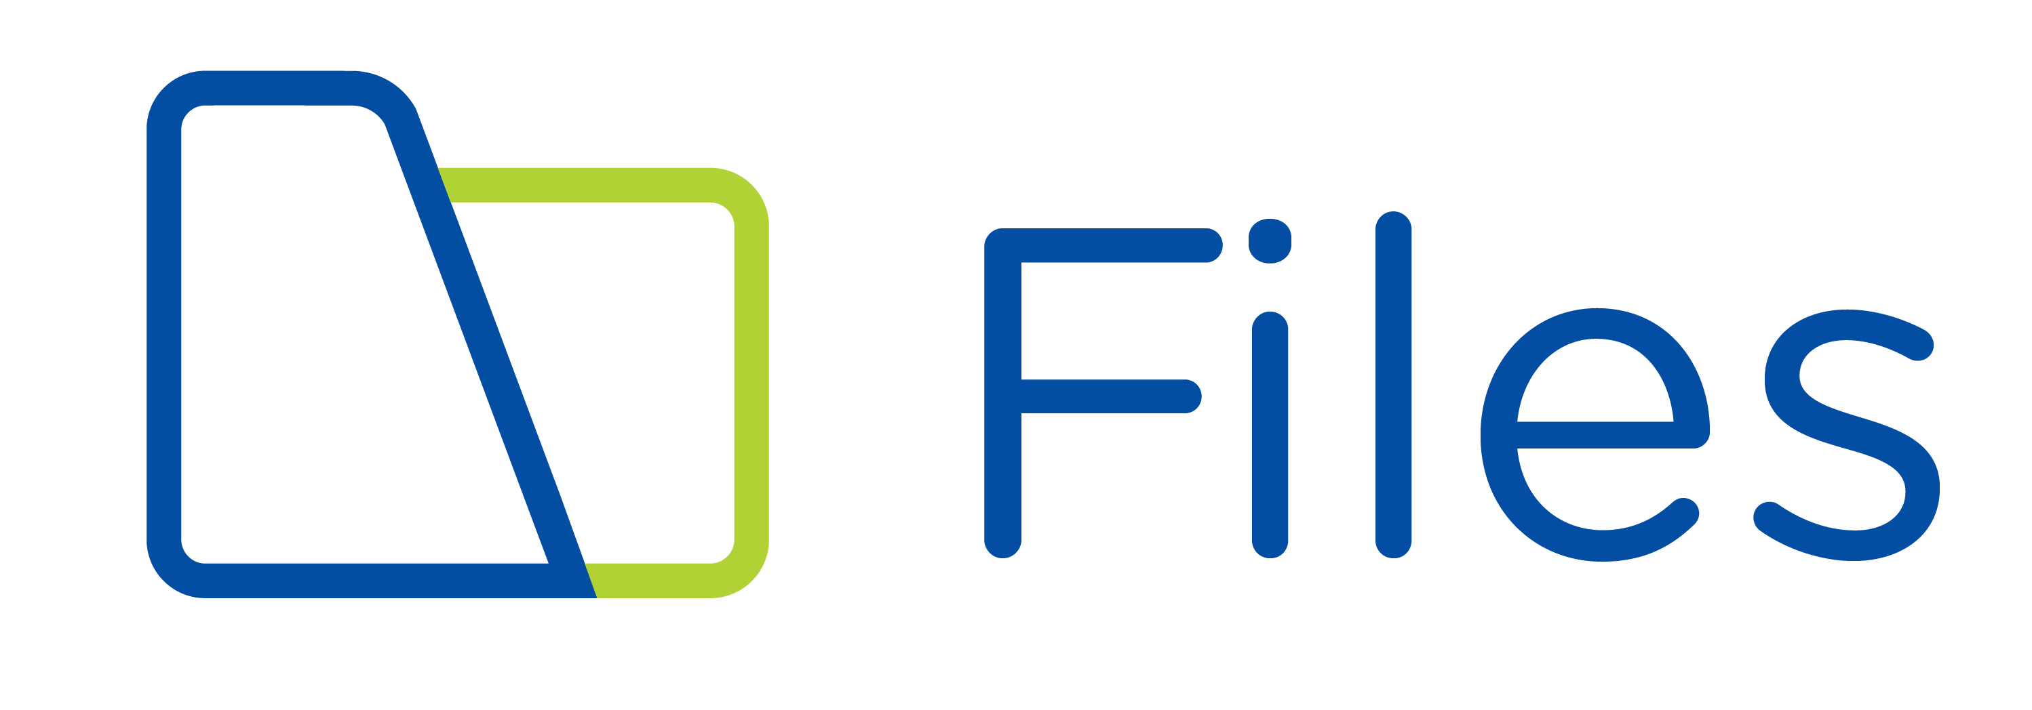
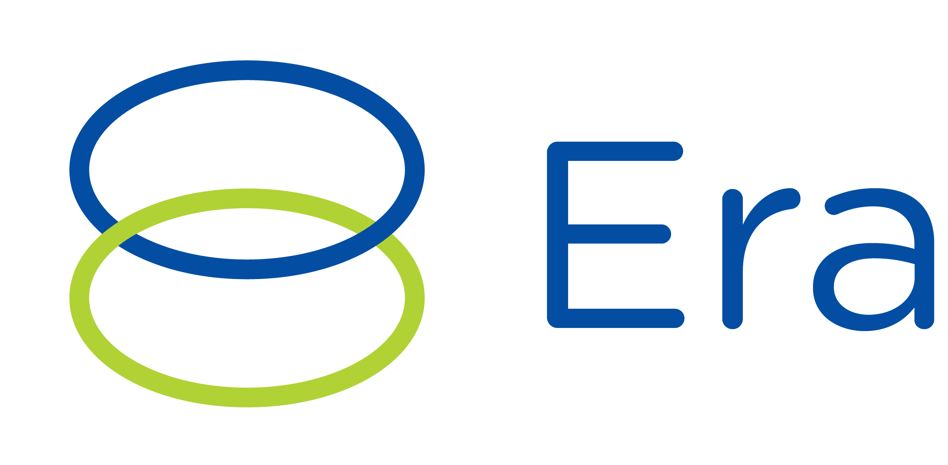
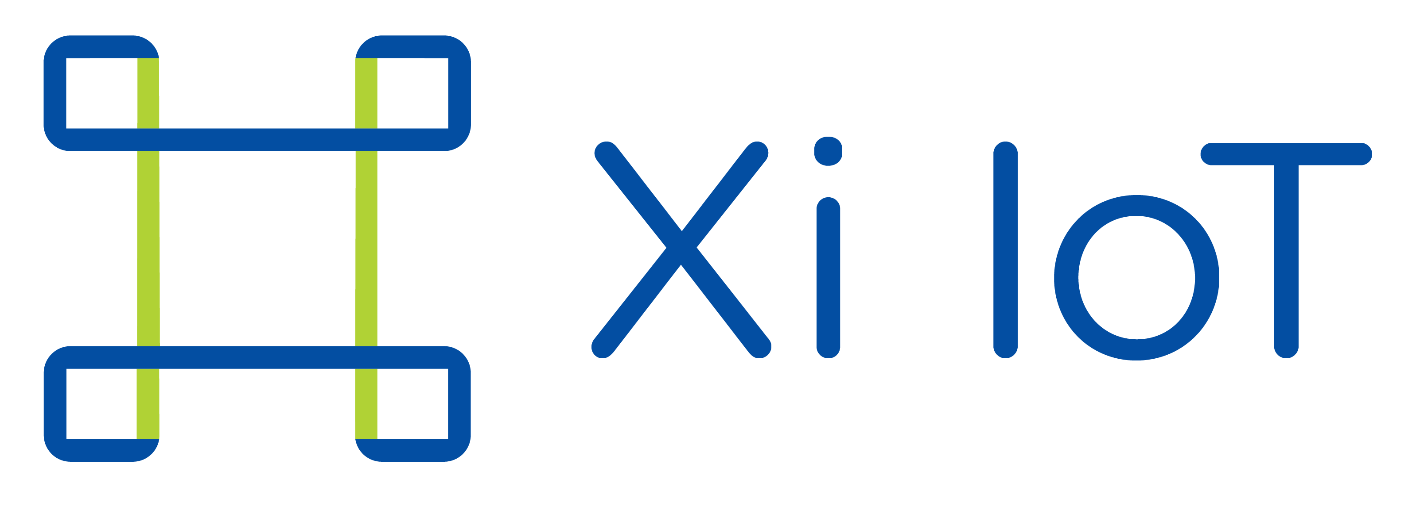
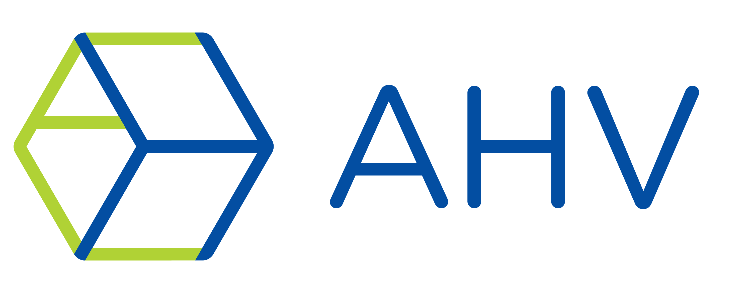
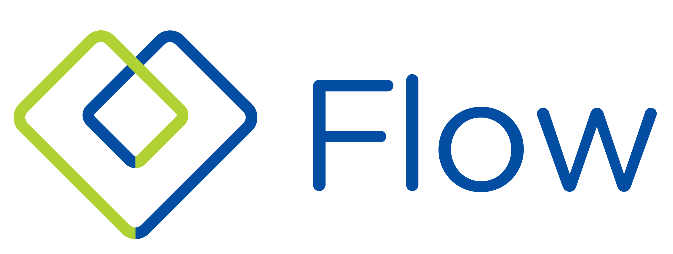


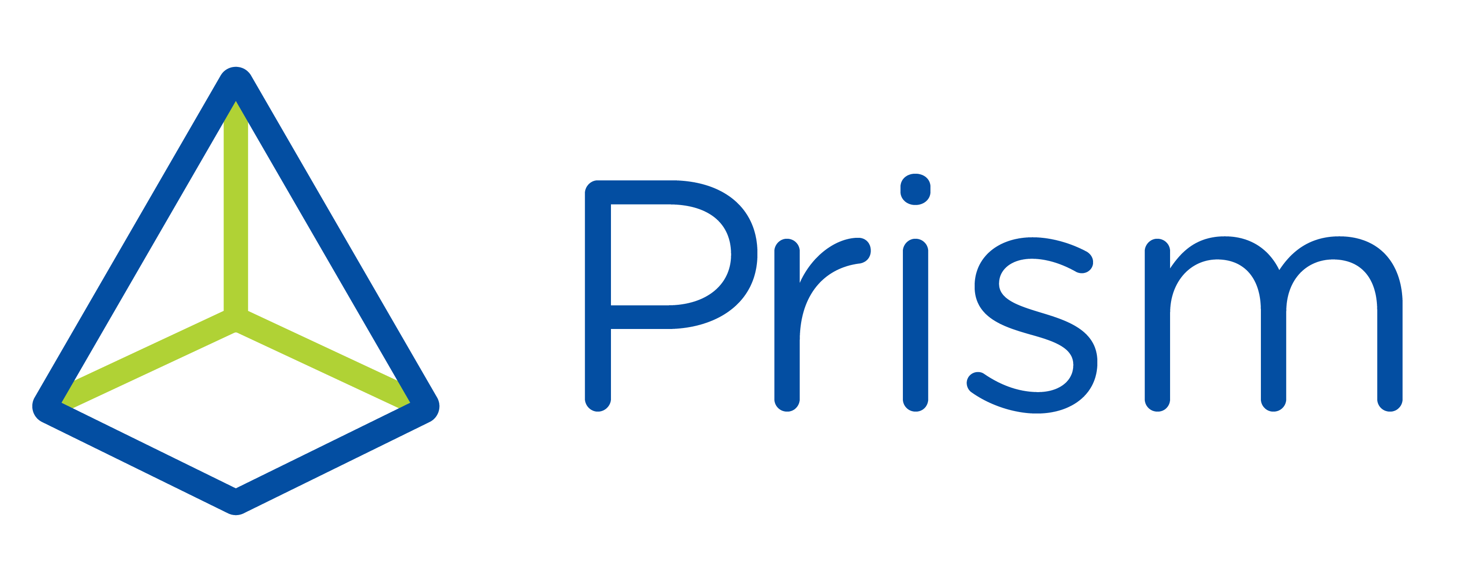

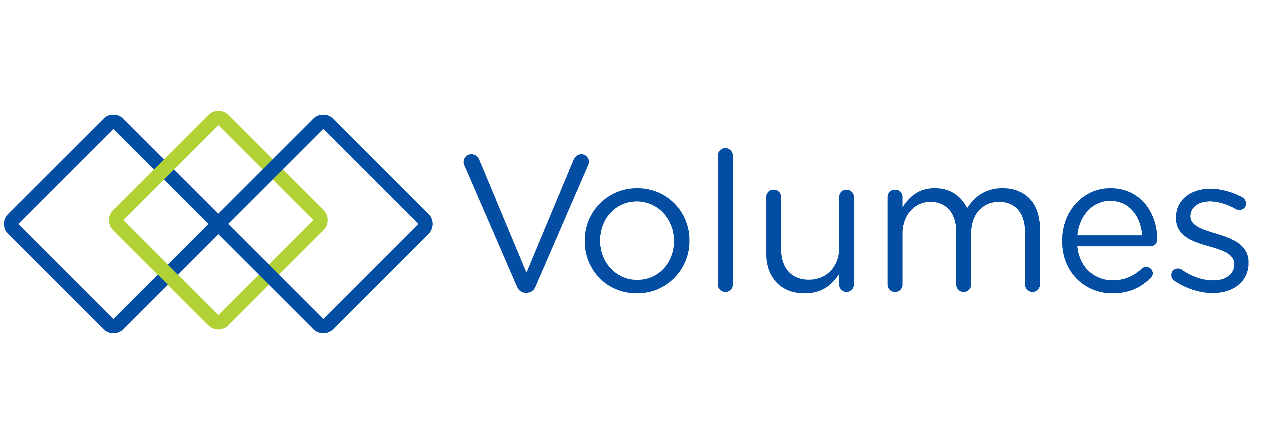




Nutanix Customer Journey
Nutanix Core
Nutanix Essentials
Nutanix Enterprise
The industry’s most popular hyperconverged infrastructure (HCI) solution.
Simple, scalable and reliable file storage for the cloud era.
Automates and simplifies database operations
Simple, Scalable, Secure Edge Intelligence for Real-time Analysis
Powerful, secure built-in virtualization that eliminates expensive hypervisor lock-in
Advanced Networking and Application Centric Network Security
Simplifies the provisioning, operations, and lifecycle management of Kubernetes.
Disaster Recovery Service delivered by Xi Cloud
Simplify infrastructure management with one-click operations
Application Lifecycle Management and Cloud Orchestration
A native scale-out block
storage solution.
Run Full Desktops and Applications in Your Browser
Simplify infrastructure management with one-click operations
Scalable, secure, enterprise-grade, S3-compatible object storage in a multi-cloud era
Observability and Monitoring
for Multi-Cloud Applications
IaaS
PaaS
Multi-cloud optimization service to reduce costs & enhance cloud security compliance.
SaaS

Slide 8

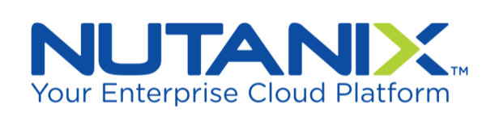





















Nutanix Powers All Workloads and Use Cases
Enterprise Applications
VDI
Remote and
Branch Office
Collaboration,
Messaging, & UC
Dev/Test
Big Data
Mission-Critical Workloads
Notes:
We report use cases each earnings release and Enterprise Apps is consistently about half.
Not just SAP, but other enterprise applications and use cases.
Highlight a couple, including other business-critical databases, VDI, extends to remote sites, and more.

Slide 9
Re-Platforming IT
App
App
Virtualization
App
App
Virtualization
Compute
Compute
Fiber Channel Switch
Fiber Channel Switch
Storage Controller
Storage Controller
Storage Controller
Storage Controller
Storage Controller
Storage Controller
Integrated compute, storage, virtualization, network, and security
Notes:
Nutanix Enterprise Cloud addresses the cost and complexity associated with traditional, three-tier datacenter infrastructure – constructed with separate storage, compute and storage networking resources. Building datacenter infrastructure with a legacy architecture requires:
Partnering with multiple vendors (servers, SAN, storage networking, virtualization, more)
Multiple weeks or months to design, procure, deploy and provision infrastructure
Difficult and time-consuming processes to increase capacity to meet business needs
Multiple management consoles, staffed by specialist IT teams
Challenging troubleshooting when diagnosing poor performance or failure
Nutanix Enterprise Cloud simplifies the design, construction and deployment of IT infrastructure. It converges all IT resources into a single scale-out solution that can run any application.
A Nutanix-powered infrastructure can be deployed in just 60 minutes or less
,IT teams can start small, with typically just three servers (nodes) and scale capacity (storage and compute) without limit
Scaling is 100% linear. Each node adds a proportionate amount of storage and server capacity. If you need to double the overall capacity of a Nutanix deployment, you simply add 2X new nodes. No more guesswork.
100% software solution that can run on off-the-shelf servers from all leading server manufacturers
The entire software stack can be upgraded in a single click, and without disruption to the live environment
Plus Nutanix-powered infrastructure uses your existing top of the rack switches.
Compelling Industry Prediction: Gartner (leading industry analyst firm) has publicly predicted that the number of workloads in a typical enterprise that will run on HCI solutions like Nutanix, will grow from only 5% in 2017 to 20% by 2020. A 4X growth in just three years.

Slide 10
Converging Storage Services
User Workloads
Node 1
Node 2
Node N
Hypervisor
Hypervisor
Hypervisor
Server
Server
Server
C1
C2
Notes:
For most datacenters, VMware and virtualization changed the game. It did so by aggregating servers, that were otherwise siloed infrastructure, into a cohesive set of the resources. IT administrators were now managing their application virtual machines and not concerning themselves with individual server resources. However, virtualization didn't go far enough in simplifying the infrastructure stack, specifically the centralized storage.
Looking at this architecture, the top half with virtualization is what the industry calls scale out. In other words, when resources are needed, you can add those resources without requiring additional management or operational overhead and without any scale limits.
The bottom half of this architecture however, is what the industry calls scale up design. In other words, the infrastructure has scale limits after which either capacity or performance is impacted. Once to limits are hit, you incur management or operational overhead. In the case of a storage array, it means either trading up for a larger array and all the process involved with an upgrade or manage to separate arrays and the complexity and operational overheads involved with managing that environment.

Slide 11
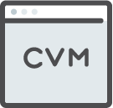

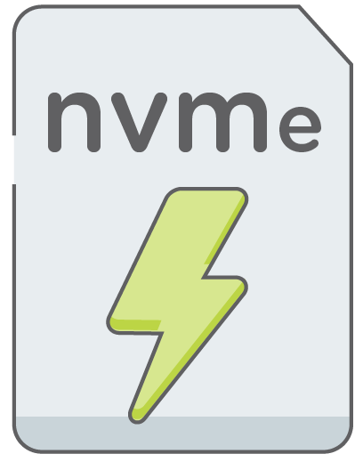

Flexible Scale-out Architecture
User Workloads
Compute & Storage Controller
Node 1
Node 2
Node N
Hypervisor
Hypervisor
Hypervisor
Server
Server
Server
Storage
Pool
C1
C2
  Start small and scale without limits
  Increase capacity one node at a time
  Keep data local for maximum performance
  Mix node types and hardware generations
Notes:
One reason Nutanix has become the most popular hyperconverged solution in the market is its distributed systems architecture, which provides unlimited scalability, high performance and unmatched resiliency.
Here are the basics:
Nutanix software is deployed on a cluster of servers or nodes — starting with at least three or four in typical datacenter deployments. (One and two-node deployment options are available for ROBO installations). Each node has CPU, memory, storage (SSD + HDD, or all-flash) and a hypervisor.
The nodes are connected via an industry-standard Ethernet switch.
The core Nutanix Acropolis (HCI) software runs in a user-mode VM called the Controller VM (CVM) on each node in the cluster. The Controller VMs create a single storage pool using the direct-attached storage in each node in the cluster. This is the Distributed Storage Fabric, or DSF. It completely eliminates the need for standalone storage arrays, like SAN and NAS products.
The DSF distributes data and metadata across all the nodes in the cluster, and provides enterprise storage features such as deduplication, compression, erasure coding, cloning and snapshotting in a truly distributed system - with no single points of failure or hotspots.
This fully distributed, scale-out architecture allows you expand capacity by adding nodes when needed - without limits. You get linear predictable performance and capacity increases as the cluster grows.
The Nutanix solution delivers data locality to provide the best VM and cluster performance. All I/O requests from a VM are handled by the local controller VM on that node. When a VM writes data, one copy of the data is always written to the local node. That way, read requests can be handled immediately using data on the same node without going over the network. If the VM moves to a different node, then over time the data also migrates to the remote node to restore locality.

Slide 12

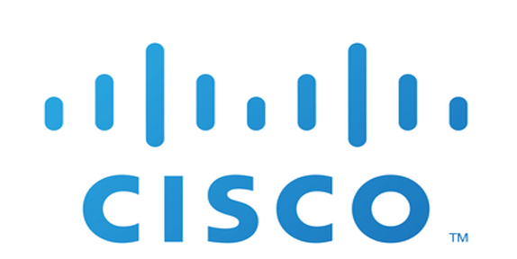


Introducing a Fully Integrated HCI Solution
Prism
One-Click HCI Management
AHV
ESXi
Hyper-V
Virtualization Choice
Acropolis
HCI Software
NX
Hardware Platform Choice

Slide 13
Enterprise-grade Storage and Security
Proven Enterprise Storage
Advanced Security
  Snapshots & clones
  Data tiering
  Compression
  Deduplication
  RF2, RF3, ECX
  App consistent snapshots
  Async replication
  Near sync replication
  Sync replication
  Metro availability
  Automated validation and self-healing
  Full stack security development lifecycle
  Client authentication
  Cluster lockdown
  Data-at-rest encryption (SEDs or software-enable w/ key mgmt.)
  STIG: Security Technical Implementation Guide
Notes:
Two of the fundamental requirements to replace proven IT infrastructure is the ability to provide all enterprise-class storage features, and ensure the best overall security.
Nutanix Enterprise Cloud solutions routinely replace all SAN and NAS storage solutions from all leading storage vendors, providing a rich set of enterprise-class storage capabilities (as shown on slide). For maximum flexibility, Nutanix provides delivers software-defined storage with the granularity of a single virtual machine.
Additionally, Nutanix solutions are build with a “secure by design” methodology, and include the richest set of security features available in the HCI industry today.

Slide 14

Built-in Virtualization
Native high-performance hypervisor
Integrated management and monitoring
Nutanix AHV
Secure; trusted by global companies
Microsegmentation & service chaining
Less Operational Complexity
Integrated Management
License Free
Notes:
Nutanix provides native virtualization with the Nutanix AHV hypervisor.
Highlights:
Leveraged popular KVM hypervisor as a foundation, then added enhanced security, faster performance and – most importantly – integrated management of the virtual environment and all VMs.
Integrating a hypervisor into a single cloud stack, also enables Nutanix customers to automatically, and intelligently place every VM to optimize cluster CPU, RAM and storage resources for the best performance and greatest efficiency.
Built-in security with STIG (security technical implementation guides) and SALT-based self-healing that resources the state of the hypervisor if it drifts from the approved configuration for any reason.
Nutanix provides the AHV hypervisor, and full virtualization management via Prism, with every software and appliance deployment. There is no additional cost, and no licenses to manage.

Slide 15
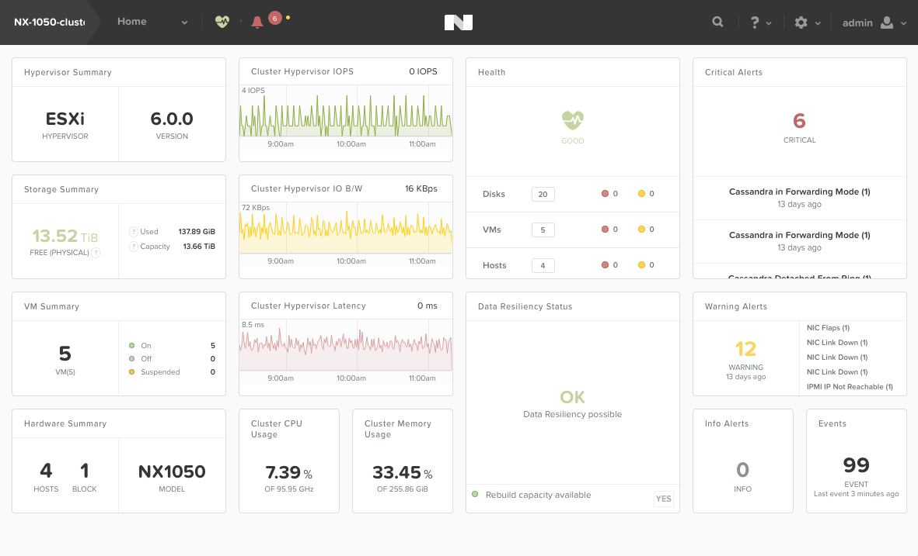
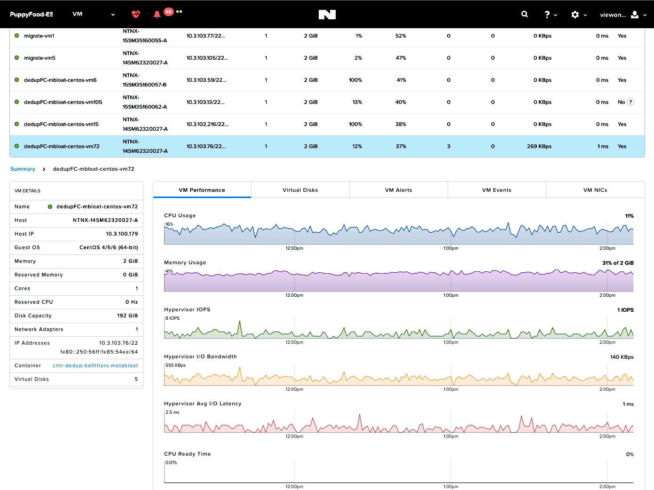
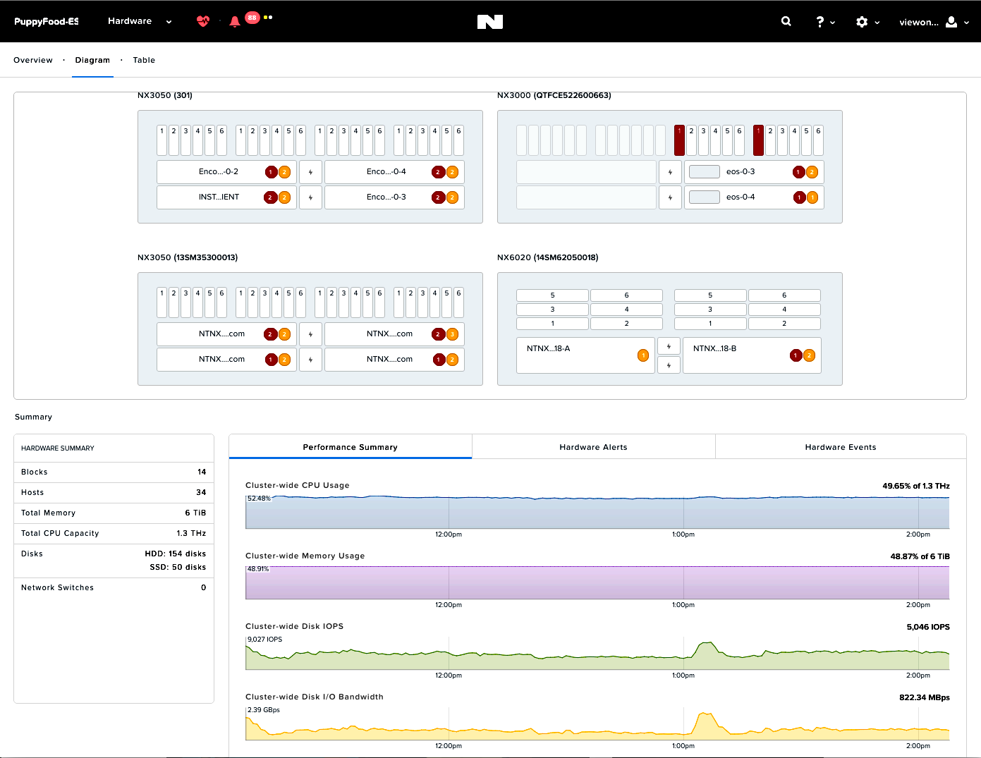
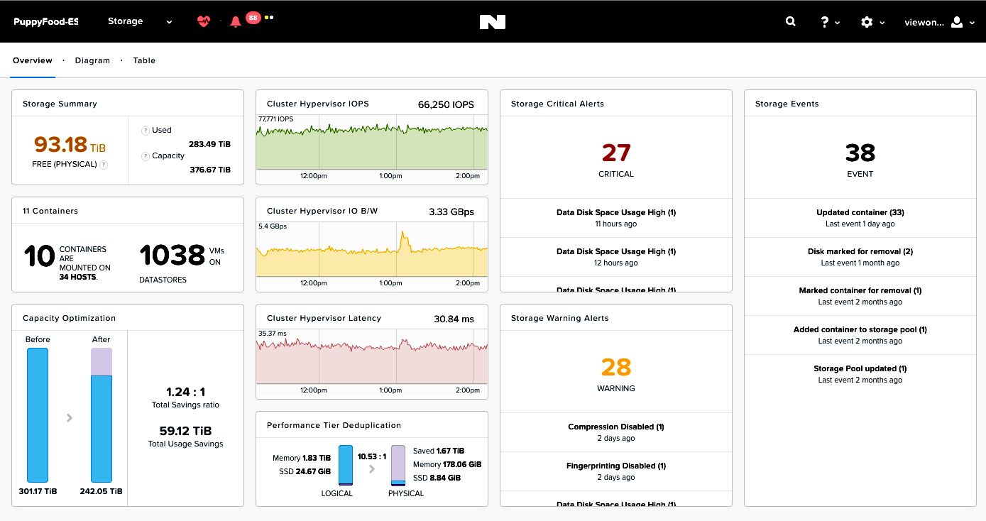
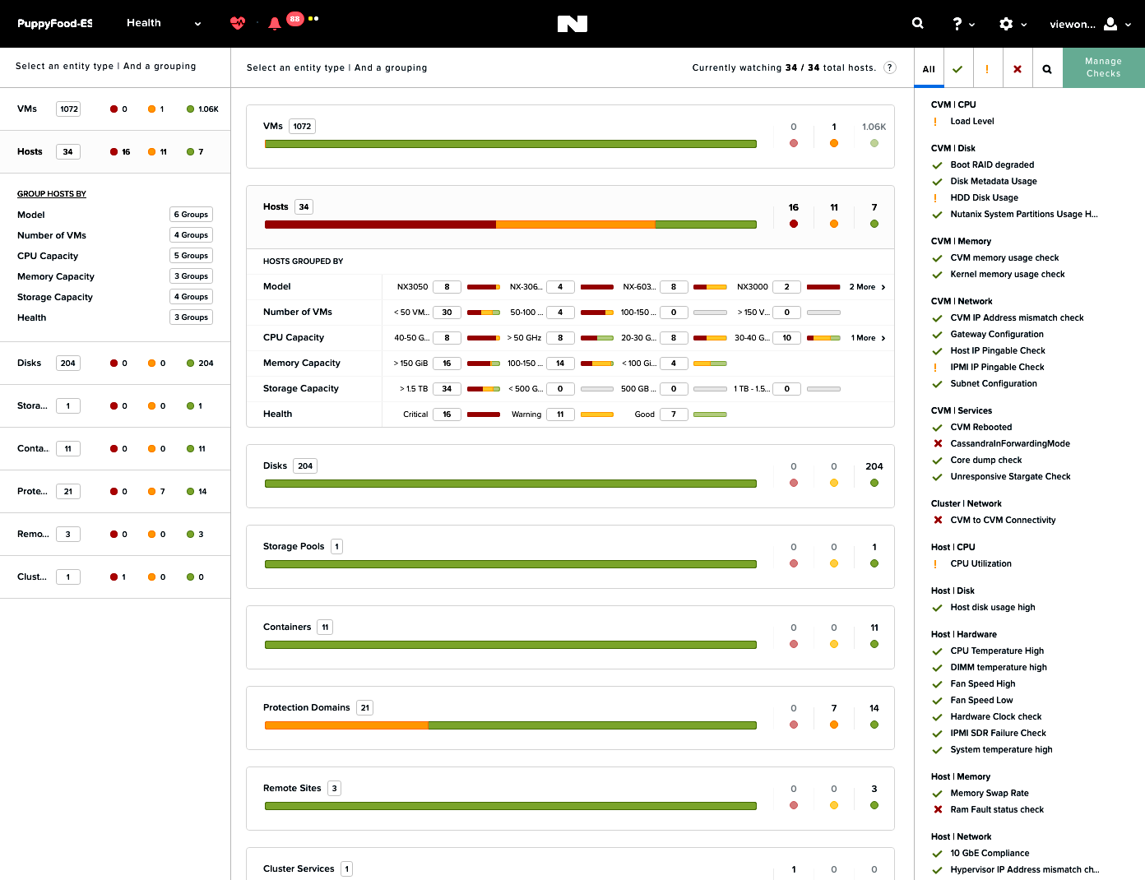
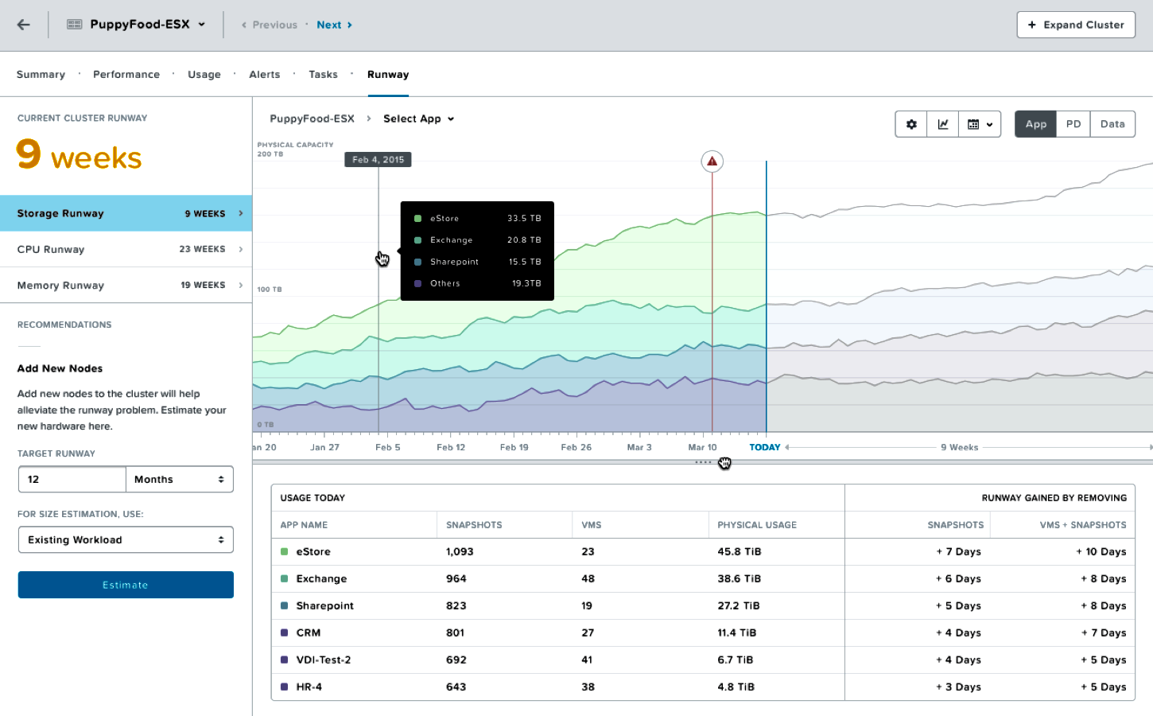
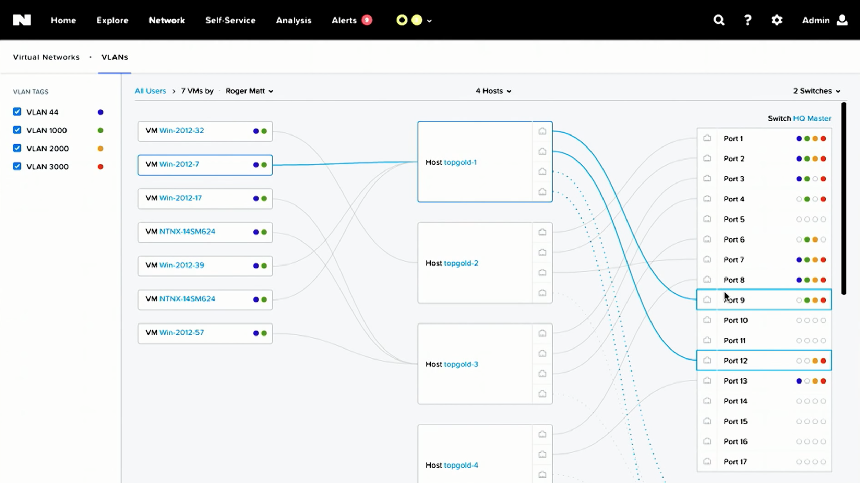
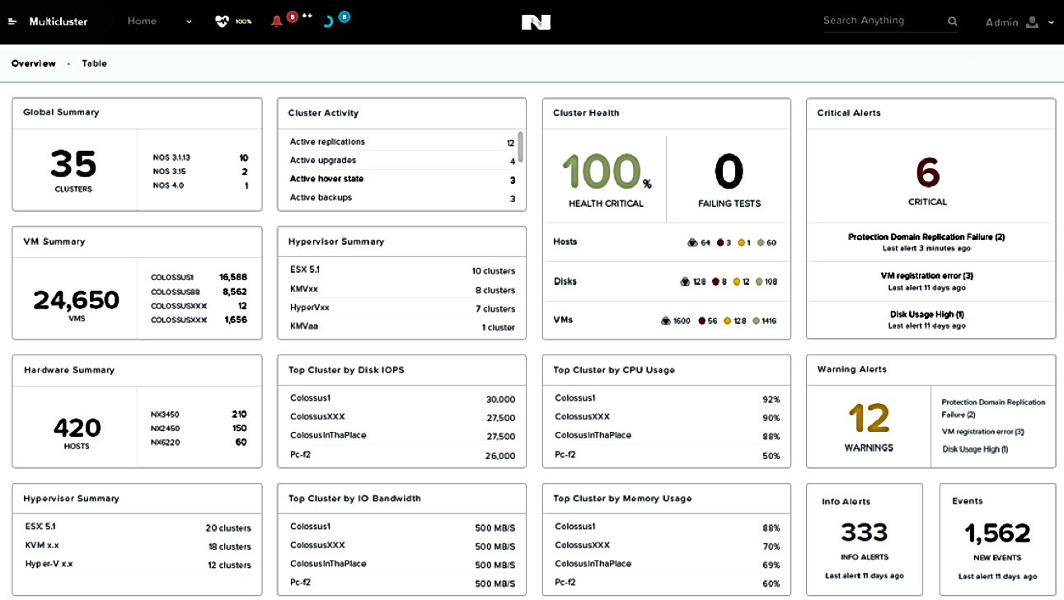
Prism: Full-Stack Management & Analytics
Compute, Storage, Networking, Data Protection Management
Virtualization Management
Operational Analytics
Cluster Health
Notes:
-Hyperconvergence solved the fundamental problem of silos between compute, storage and virtualization in the legacy 3-tier datacenter. The same silos existed on the management side, with different vendors for the management of each of the different layers of the 3-tier stack. The problem gets compounded, if you bring in virtualization management, operational analytics, app automation, and multi-cloud management. Imagine the number of tools you would need to manage each of these in your datacenter. Nutanix Prism solves this problem by providing a single pane of glass , like the eye in the sky with visibility across all these different elements, thereby providing consolidated management.
-Customer Delight is our key guiding principle when it comes to management. Prism would remind you of the Apple or Tesla UX experience.

Slide 16
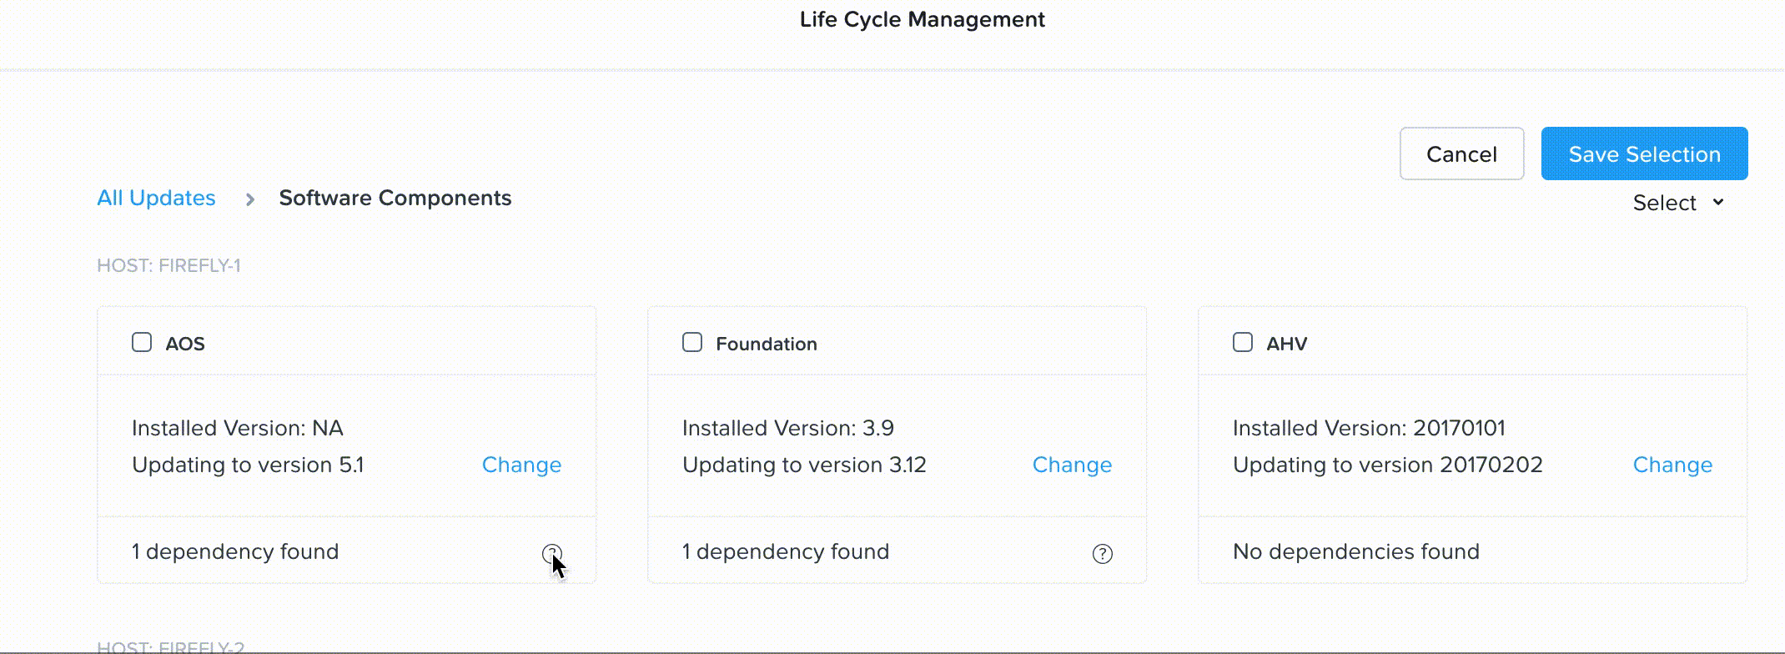
Non-Disruptive, Dependency-Aware Upgrades
Firmware
OS
Hypervisor
Software

Slide 17
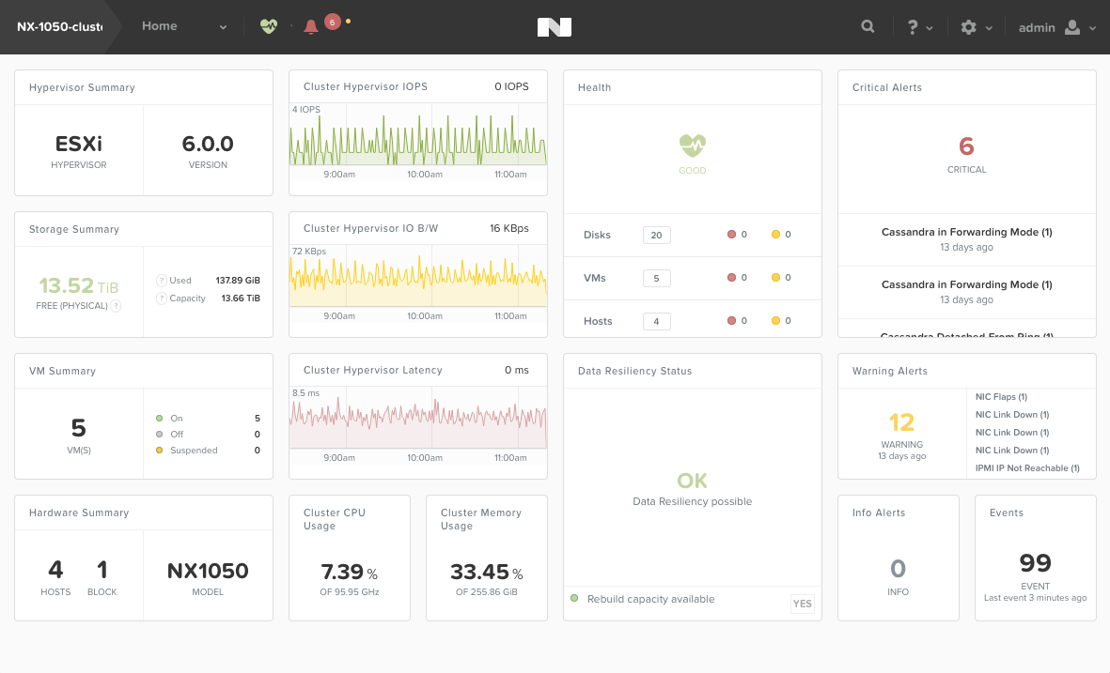
Full Lifecycle Management
Buy
Scale without Limit
  Add one node at a time
  Automatic redistribution
  100% linear performance
Easy Deployment
  Quick cluster install
  Auto-discovered nodes
  Simple infra sizing
Scale
Deploy
One-Click Upgrades
  Nutanix software
  Hypervisor
  Firmware and BIOS
Simple Management
  Single pane of glass
  No IT expertise required
  Access on any device
Upgrade
Manage
Troubleshoot
Real-time Insights
  Machine Learning engine
  Capacity Planning
  Anomaly detection

Slide 18



















Nutanix Customer Journey
PaaS
Nutanix Enterprise
*
Nutanix Essentials
SaaS
IaaS
Nutanix Core
*
*Under development
Notes:
This is our new portfolio segmentation – Core/Ess/Ent
C/E/E represents our Nutanix customer journey. It captures and illustrates how customers can modernize their datacenter with Nutanix HCI.
Core
is the first step. Deploying Acropolis software, managed by Prism – and optionally using AHV for virtualization. This is how nearly all of our 11,000+ customers start with Nutanix. HCI is the CORE. It is the foundation of our portfolio. It is the initial step in the Nutanix journey.
Essentials
Once successful, Nutanix customers build on this core HCI foundation, introducing additional software-driven cloud capabilities.
This includes:
Not just running mission-critical applications on our Nutanix Enterprise Cloud stack, but also managing these workloads, through their entire lifecycle with Nutanix Calm.
Securing these applications with Nutanix Flow, and automating network operations
Leveraging our robust HCI foundation to breakdown additional storage silos. Acropolis, of course, already eliminates SANs. Now with Nutanix Files, we can simplify management of file-based storage – giving our customers an alternative to NetApp filers, and other file systems. Built-in file storage - provisioned and managed via Prism, delivering that unmatched one-click experience.
And lastly, extending HCI management with Prism Pro – bringing more automation and analytics capabilities, powered by advanced machine learning.
All of these Essentials products are generally available now. And, each is managed natively in Prism.
Once our customers have embraced the full Nutanix stack in their datacenter to run all of their workloads, the next step in the Nutanix journey is to build a true hybrid cloud with Nutanix Enterprise.
Nutanix Enterprise
The portfolio of software solutions and services that are part of Enterprise in broad
In building a hybrid cloud, one needs not only infrastructure as a service (IaaS) – derived from Nutanix Core and Nutanix Essentials but they require PaaS, or platform services, as well as cloud-delivered services
Enterprise includes PaaS services such as database as a service with Era, Kubernetes as a service with Karbon, and Buckets as a native object store
Xi Cloud services.
Xi is now an umbrella brand, or a family name – representing all Nutanix cloud services. This includes, of course, cloud-based DR service which is now Xi Leap.
The other Xi Services, all part of Enterprise, are
Xi Frame for delivering desktops and applications
Xi Beam for optimizing cloud costs and security compliance for workloads running in both public and private clouds
Xi Epoch for application observability and monitoring across different cloud environments
And finally, Xi IoT - a platform for developing and running applications at the edge, cloud-connected and running at scale
So that’s it. A three-step journey for our customers.
Building the foundation with Nutanix Core
Bringing cloud-like functionality to the datacenter to run all workloads with Nutanix Essentials
Building a hybrid cloud with Nutanix Enterprise
C/E/E are not bundles. There are no new SKUs. We are simply making initial recommendations as to what solutions we think make most sense for customers, at each stage of their journey. You can still tailor your offerings to each customer, based on their individual needs.

Slide 19

VDI on Nutanix HCI
Predictable, Linear VDI Scale
One-Click VDI Integration
Simplify VDI
App
App
Virtualization
Virtualization
4 Node
1200 VMs
4 Node
800 VMs
4 Node
400 VMs
Notes:
Simplify infrastructure with predictable, linear scaling HCI appliances.
Pay as you grow with bite-size building blocks that are certified to work with Citrix and VMware.
One-click simplicity in stack management from a single pane with one-click integration and certified ready plug-in integration.

Slide 20
Industry’s Best Support
Over 100 Countries
7 WW Support Centers
Amsterdam
Beijing
24x7x365
“Follow the Sun” Support
Durham
Tokyo
San Jose
Proactive Support with Pulse
Bangalore
<30 min Mission Critical Support Response Time
Sydney
97% Customer Satisfaction
+90 Net Promoter Score
for > 4 Years
Support Centers
NBD Depots
Notes:
Outstanding support is a hallmark of Nutanix. We are extremely proud of the services that we provide to our customers, and encourage any organization interested in Nutanix to inquire about our support services and learn how we can be your strategic IT partner for your most critical projects.
Highlights
An audited Net Promoter Score (NPS) of 90+ for five consecutive years. NPS measures the likelihood of they recommending Nutanix to a peer. The average software company has an NPS of 30. A score of 90+ is virtually unheard of.
What drives Nutanix support excellence:
All Nutanix support engineers are full-time employees. You will never talk to a contract support person
Nutanix does not employ a tiered support model, with different levels of support engineers. The site reliability engineer (SRE) that takes the initial support request will handle the case until resolution. Customers are never waiting for handoffs within the support team.
Only Nutanix customers decide when a case is resolved to their satisfaction. Nutanix does not close a support ticket on our own.
Nutanix SRE teams leverage Nutanix Pulse to proactively address support issues; sometimes without the customer calling or submitting a ticket

Slide 21



Solutions for Remote and Branch Offices
Deliver Multiple Services
Physical Footprint
Backup
Management
Single platform for all workloads
High performance
1, 2, 3, …n node deployment options
Hardware choice
Built-in replication
One-node back-up option
Cross-hypervisor DR
Centralized management for all sites
One-click, scheduled upgrades
Common datacenter and ROBO administration

Slide 22
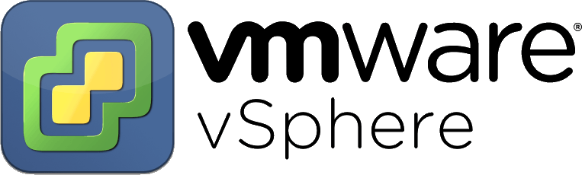
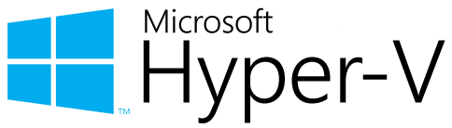
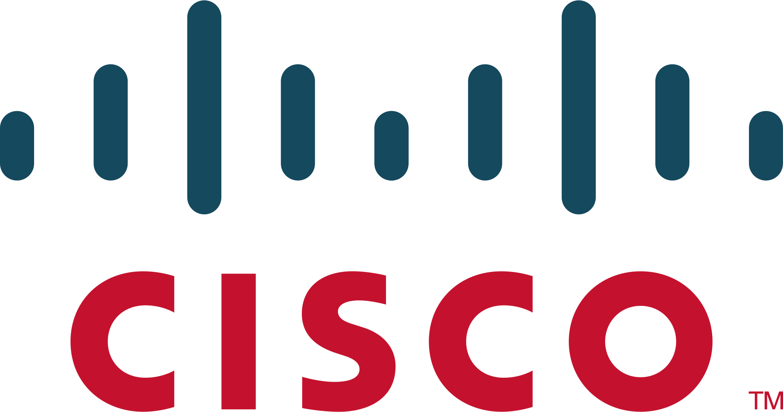
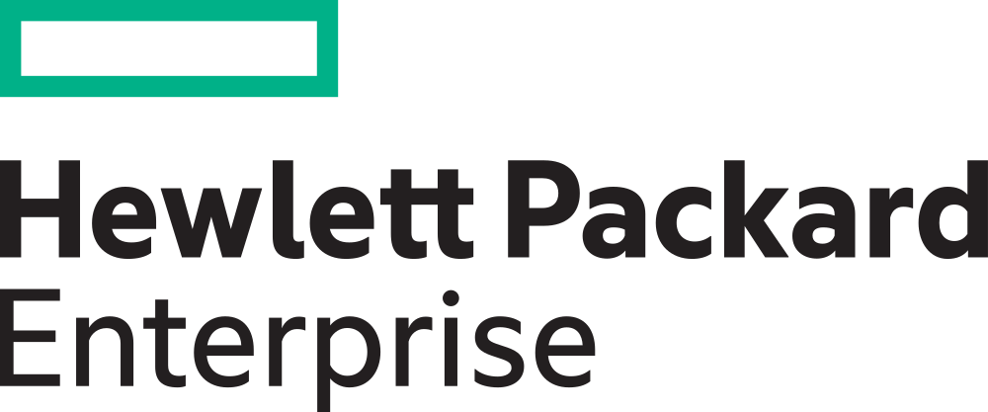

Freedom to Choose
Hypervisor Choice
Nutanix AHV
Platform Choice
More
Notes:
Since its founding, Nutanix has led the industry in providing customers with the freedom to choose the right technologies for each use case. This extends to:
Support for all popular hypervisors, including Nutanix’s native AHV
Freedom to select the best server hardware, while preserving a consistent operational experience via Nutanix Prism
Ability to seamlessly integrate public clouds into the IT environment, and manage applications across different clouds, including AWS, Google Cloud, Azure and – of course – Nutanix Xi.

Slide 23


Nutanix Beats Three-Tier Architectures
60%
97%
534%
7
$10.56M
lower TCO
fewer unplanned outages
five-year ROI
months to payback
additional revenue per year
Source: IDC White Paper, sponsored by Nutanix, Nutanix Delivering Strong Value as a Cost-Effective, Efficient, Scalable Platform for Enterprise Applications, August 2017
Notes:
Nutanix’s approach to infrastructure offers real, tangible, material benefits to customers in terms of greater agility, faster time to value and lower Total Cost of Ownership. A study conducted by IDC to quantify the benefits of Nutanix infrastructure found that customers get over 500% Return on Investment over a 5 year period, and 60% lower TCO with a 7-month payback period.
The biggest benefits are in terms of better business productivity and agility and lower operational expenses – Nutanix systems reduce management time by over 60% and reduce unplanned downtime occurrences by 97% and allow customers to be more agile in responding to new needs from the business by being able to deploy new compute 73% faster, new storage 68% faster and almost 40% less time for deploying hypervisor (38%).
Remember to:
Pick one or two of the numbers from this slide and dig in. Don’t try to talk about each of the numbers at length
Emphasize that this is an independent third-party study. IDC interviewed the customers themselves. Nutanix wasn’t involved in the study beyond making introductions. We weren’t even on the calls. The customers provided their insights on how Nutanix has helped them when they moved from legacy 3-tier infrastructure.
The business value from hard cost savings like power, cooling, rack space, networking and software costs. But there are also tremendous benefits from simplified management by spending less time on the day to day operations as well as the resiliency (less downtime) and performance gains that make employees more productive.
IDC found that Nutanix makes organizations more agile and able to capture business value – quantified as $10.56M per organization per year. There are some great quotes in the report about how a particular company could focus their IT on the business and not on running their infrastructure.
Customers and prospects can go online to www.Nutanix.com/tco to get the report and to input their own data to get a customized version with their unique results.

Slide 24
Thank You

