Slide 1
Gummy smiles

Slide 2
The smile Normal architecture
Dental Smile Esthetics : The Assessment and Creation of the Ideal Smile
Semin Orthod 2012; 18: 193-201
Pratik K. Sharma and Pranay Sharma

Slide 3
The smile Normal architecture
The architecture of the smile is divided into three components
The lip framework
The gingival tissue
The dentition

Slide 4
The smile Normal architecture : the lip framework at rest
At rest :
Prosthodontics guideline 2 to 4 mm are displayed at rest
The factor of influence are :
Upper lip length
The age
The race
The sex

Slide 5
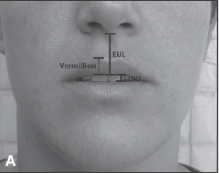
The smile Normal architecture : the lip framework at rest
Lip length :
Measure from the base of the nose to the edge of the upper lip
From 10 to 36 mm
Average 20 to 22 mm

Slide 6
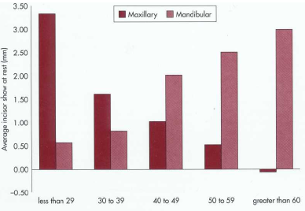
The smile Normal architecture : the lip framework at rest
Age :
At an early age gingival display
As age increase the muscle lose of their tonicity and elasticity
Consequently both upper and lower lip drope
The display of the upper teeth is decreased
The display of the lower teeth is increase

Slide 7
The smile Normal architecture : the lip framework at rest
sex
The female are more prone to gingival display than the male.
In is private practice Dr Polo an expert on Botox treatment, treated 96% of women and 4% of man.

Slide 8
The smile Normal architecture : the lip framework in function
Their is two type of smile
The spontaneous smile: involuntary, linked to emotion.
The posed smile : voluntary smile, fairly reproducible the one we are interested in

Slide 9

The smile Normal architecture : the lip framework in function
During the smile
the lower border of the upper lip define the upper smile line
The upper border of the lower lip define the lower smile line
Ideally the upper smile line should display 1 to 2 mm of gingiva.
A high smile line of gummy smile define a gingival smile

Slide 10
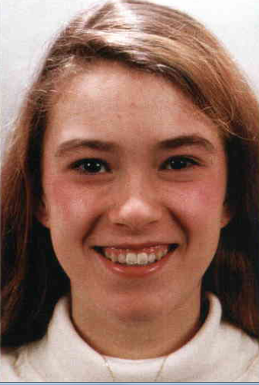
The smile Normal architecture : the lip framework in function
The smile arc
The relationship of the curvature of the incisal edges of the maxillary incisors with the curvature to the lower lip in a posed smile.
In an esthetic smile those two line should be parallel and touch each other.
With age the edge of the anterior teeth often flatten
The vertical dimension spacio analysis of those components are very important

Slide 11
The smile Normal architecture : the lip framework in function
The smile arc
also midline and buccal corridor.
No really related to the subject today.
In any case the more recent study show that those tow parameters are not very important.
A lay person will not notice a midline discrepancy in relation to the facial midline of less than 2mm
But a lay persone will be sensitive to the axis of the central incisor
A lay person will not judge buccal corridor to be inesthetic unless their are asymmetric

Slide 12
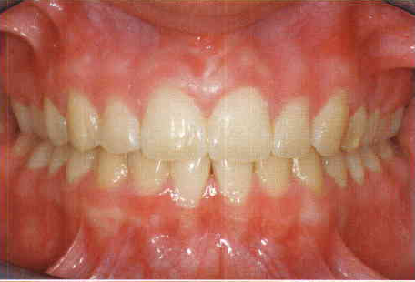

The smile Normal architecture : the gingiva
Healthy gingival soft tissues have the free gingiva that extends from the free gingival margin coronally to the gingival groove apically, and it is keratinized and has a coral pink dull surface.
The attached gingiva is keratinized and can be highly stippled or smooth. The alveolar mucosa is apical to the mucogingival junction, with a loose and darker appearance.
An regular arrangement of the gingival tissues is necessary to esthetic outcome

Slide 13
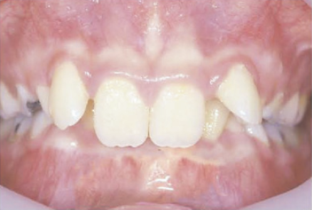
The smile Normal architecture : the gingiva
The gingival architecture of the central incisor teeth should mirror one another.
The gingival contour of the lateral incisors should lie more coronal to the central incisors and canines and be bilaterally symmetrical.
The canines, should have the level of the free gingival margin at the same height as the central incisor teeth and matching one another
This situation represent an ideal Class I smile
A common variation is with the Class II patient
the gingival contour of the lateral incisors lies apical to that of the central incisors and canines.

Slide 14
The smile Normal architecture : Teeth shape
Optimal smile esthetics can only be achieved if the clinician has knowledge and understanding of tooth form; arrangement, color, and texture of natural teeth; and how they relate to other facial structures.
It is an important step in the evaluation of a gingival smile

Slide 15
The smile Normal architecture : Teeth shape
In geometric terms, tooth shape can essentially be divided into :
square
ovoid
triangular

Slide 16
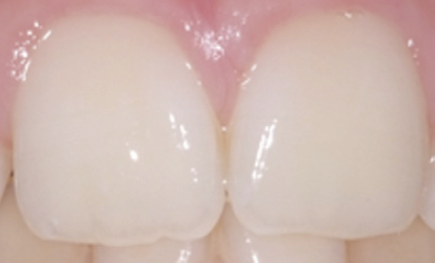
The smile Normal architecture : Teeth shape
Square teeth are characterized by straight mesial and distal outlines and parallel transitional line angles and lobes
These teeth have a large cervical area, and the incisal edges are generally straight.

Slide 17
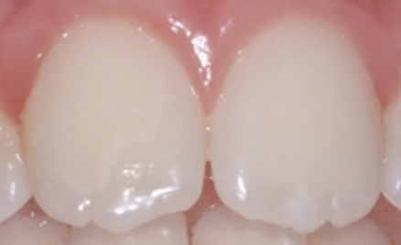
The smile Normal architecture : Teeth shape
Ovoid teeth are characterized by :
curved mesial and distal outlines
smooth transition line angles.
Incisal to cervical convergence results in a narrow cervical area and more rounded incisal edges

Slide 18
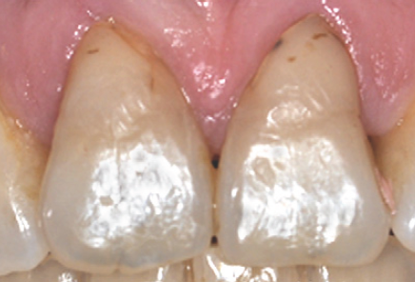
The smile Normal architecture : Teeth shape
Triangular teeth are characterized by :
a straight outline, with marked transition line angles and lobes.
a more prominent convergence from incisal to cervical, especially on the distal
outline, which is clearly inclined, defining a narrow cervical area
The incisal edges tend to be slightly curved.

Slide 19
The smile Normal architecture : Tooth size and proportion
Width/length ratios of normal clinical crowns of the maxillary anterior dentition in man
John D. Sterrett, Trudy Oliver, Fonda Robinson, Weston Fortson, Ben Knaak and Carl M. Russell
Journal of clinical Periodontology 1999; 26: 153-157

Slide 20
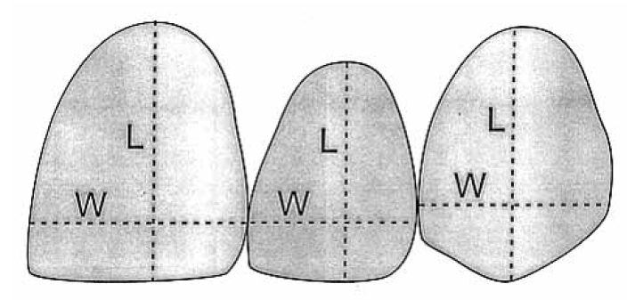
The smile Normal architecture : Toothe size and proportion
Material and method
Subject of more than 20 year old
the free gingival margin on the facial surface of teeth in the maxillary sextant was positioned apical to the cervical bulge
there was no evidence of attachment loss; as determined by lack of a detectable CEJ the marginal tissue was knife edged in form, firm in consistency and coral pink in color.
24 for male and 47 female meet those requirement
Impression were taken
The length of the teeth was defined by the longest segment parallel to the long axis of each teeth
the width was defined as the widest segment perpendicular to the long axis of the teeth

Slide 21
The smile Normal architecture : Toothe size and proportion
the ideal maxillary central incisor should have a width-to-length ratio of approximately 0.75-0.85.
A ratio 0.6 would create a long narrow tooth
A ratio 0.85 would result in a short wide tooth.
On average, the central incisor may be between 9.5 and 10.2 mm in length and 8.1 and 8.6 mm in width.

Slide 22
Brake clinical publication with miniscrew
Correction of deep overbite and gummy smile by using a mini-implant with a segmented wire in a growing class II Division 2 patient
Am J Orthod Dentofacail Orthop 2006; 130:676-85
Tae-Woo Kim, Hyewon Kim, and Shin-Jae Lee

Slide 23
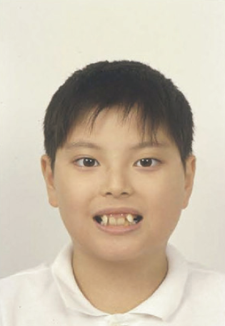
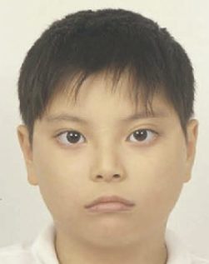
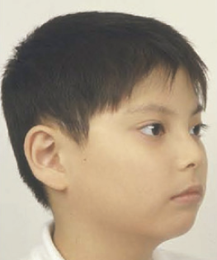
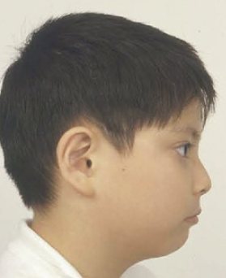
Clinical presentation
Patient 10.5 year at the initial consultation
Chief complaint gummy smile and crowding

Slide 24
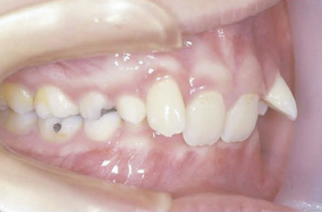
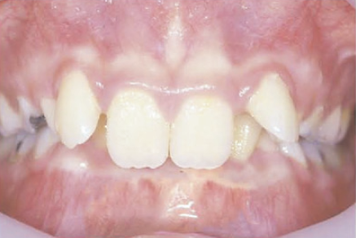
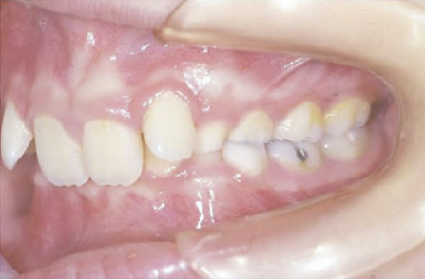
Clinical presentation
There was a full class II dental molar relationship

Slide 25
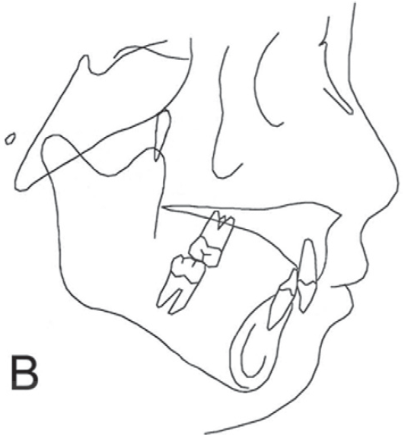
Clinical presentation
The cephalometric analysis show
a skeletal class II (ANB 9°)
A linguo version of the incisor both upper and lower
A profound deepbite
What is the normal distance of the incisal edge to the stomion ?
2 mm to 4 mm
This patient as a 8 to 9 mm distance
The author therefore chose to intrude and procline the upper incisor in a first phase
than proceed to growth modification

Slide 26
Clinical presentation
There was two option for the intrusion proclination of the upper incisor
a 2×4 fixe appliance with a high pull headgear
The 2×4 will lead to an extrusion disto version of the upper six
this will lead to a counter clock wise rotation of the mandible
and to an increase of the class II
To avoid this effect the high pull head gear is used

Slide 27
Clinical presentation
The second option was to use skelletal anchorage for inturding the anterior teeth.
Miniscrew were chosen

Slide 28
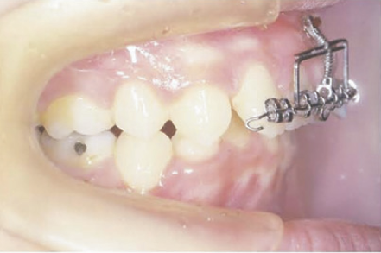
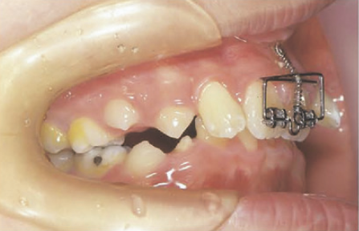
Clinical presentation
A box shaped segmental wire made of .019×.025 SS to protect the gingiva
A coil spring was used to intrude and procline the upper incisor at the same time.
5 month were necessary to correct the deep bite

Slide 29
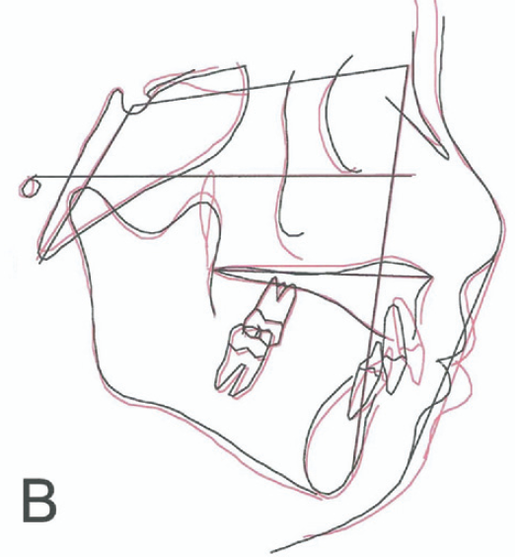
Clinical presentation
Just by the action on the upper incisor there was:
a proclination of the lower incisor
A protrusion of the lower lips which is not related to the growth
The patient is now class II division I

Slide 30
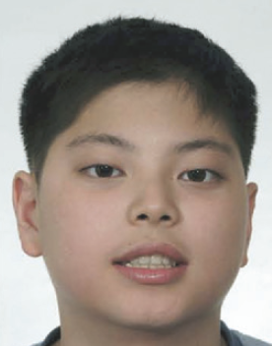
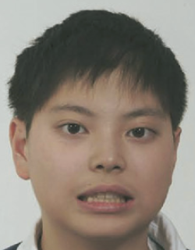
Clinical presentation
10 Year 6 Month initial visit
12 Year 8 Month end of treatment
1 year post-retention
Can You do the same ?
More importantly If you could would you do it

Slide 31
Clinical presentation
Dynamic smile visualization and quantification: Part 2. Smile analysis and treatment strategies
David M. Sarver, DMD, MS, and Marc. Ackerman, DMD
American Journal of Orthodontics and Dentofacial Orthopedics Volume 124, Number 2 116 - 127

Slide 32
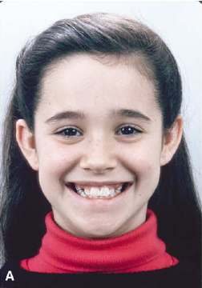
Clinical presentation
Maxillary canines were blocked out with insufficient room to erupt. patient had moderately excessive negative space on smile and excellent incisor display and smile
arc.
If you compare with the last case the situation are some what equivalent. The same amount of gingiva are shown, but on the lateral instead of the central

Slide 33
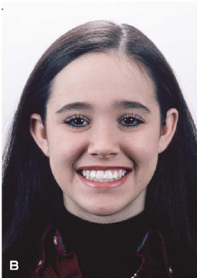
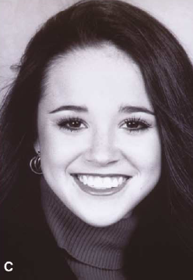
Clinical presentation
Rapid palatal
expansion was recommended to increase maxillary arch length and avoid extractions.
Result at the end of treatment. The smile was perhaps too wide
But the smile line was almost perfect
But with maturation of the soft tissue the smile began perfectly adapted to the face

Slide 34
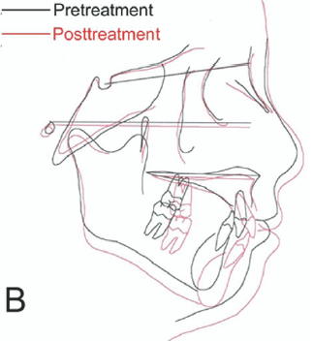
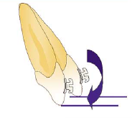
Clinical presentation
In this case the diagnostic was based mainly on the cephalometric analysis
When looking at the incisor during the smile display, the border the position of the incisal edge was just a little too low
This was due mainly to the retroclination, proclination alone would have bring them at the level of the lower lip
The additional intrusion on two mm created a low smile line
With maturation of the soft tissue the low smile line increase
The result was an insufficient exposure of the upper incisive and an excessive exposure of the lower of the lower incisor
Mimicking the smile of a 60 year old patient.

Slide 35
Gingival smile what the orthodontist must know : Gingival maturation
Because we orthodontist treat mainly children and adolescent we must have a good understanding of the evolution of the soft tissue in the young adulte and adolescent.
In case of a supected gingival smile two points are of interest

Slide 36
Gingival smile what the orthodontist must know : Gingival maturation
The eruption of a teeth is composed of two parts:
The teeth emerging into the buccal cavity and comming into occulusion : active eruption. At this stage usually 50% of the anatomical crown is exposed in the buccal cavity
The apical migration of the gingiva : passive erutpion, usually it will stabilise at 1 to 2 mm of the CEJ

Slide 37
Gingival smile what the orthodontist must know : Gingival maturation
The position of the gingival margin as expressed by clinical crown height in children aged 6-16 years
Journal of dentistry 1976 116-122
A. Volchansky, BDS, P. Cleaton-Jones, BDS, MB BCh, PhD, DA

Slide 38
Gingival smile what the orthodontist must know : Gingival maturation
This was a cross sectional study
237 pre-orthodontic treatment study model were obtained
The age of the patient ranging from 6 to 16
The length of the clinical were measured
The aim of the study was to found :
if there was an increase of teeth length with age
if there was an leveling off of the increase at a certain age

Slide 39
Gingival smile what the orthodontist must know : Gingival maturation
The statistical analysis showed that
There was an increase in the length of all teeth with age except the second mandibular molar in the studied population

Slide 40
Gingival smile what the orthodontist must know : Gingival maturation
For the mandibular teeth the increase in size level off :
at the age of 10 for the central incisor
at the age of 12 for the canine premolar and first molar
No leveling was observed for the lateral incisor
For the maxillary teeth
At the age of 12 for the central incisor, canine , second premolar and first molar
No leveling was observed for the lateral incisors, first premolars and second molar

Slide 41
Gingival smile what the orthodontist must know : Gingival maturation
The main limitation of this study was that it was not a longitudinal
Clinical crown length changes from age 12–19 years: a longitudinal study
L.A. Morrowa, J.W. Robbinsb, D.L. Jonesc, N.H.F. Wilsona
Journal of Dentistry 28 (2000) 469–473

Slide 42
Gingival smile what the orthodontist must know : Gingival maturation
Material and method
The dental cast of 456 subjects taken at the age of : 11-12,14-15 and 18-19 year old were studied.
Length measurement were performed on the 11, 13, 22 and 31 of each set

Slide 43
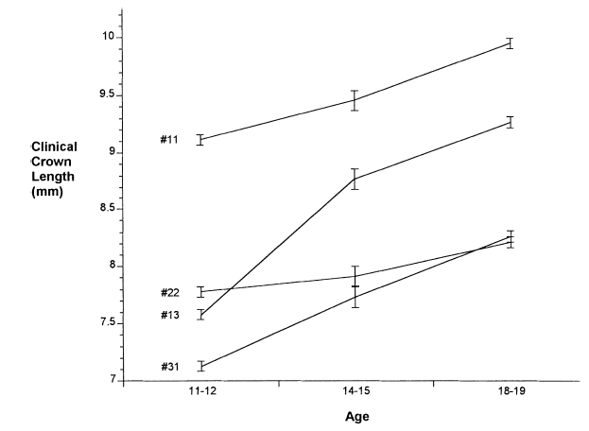
Gingival smile what the orthodontist must know : Gingival maturation
The results of this study are not in agreement with those reported in the previous study.
The data in this study indicates that passive eruption continues at least until age 18–19 years in the maxillary central incisors, lateral incisors, canines, and mandibular central incisors for both males and females

Slide 44
Gingival smile what the orthodontist must know : Gingival maturation
The maxillary central incisor, lateral incisor and canine teeth results showed a 0.5 mm change in the clinical length the ages of 14–15 and 18–19 years.
This finding is considered to be of importance to the clinician who is making treatment decisions for teenagers and young adults regarding the timing of restorative treatment which may approximate the gingivae in the anterior segment of the mouth.

Slide 45


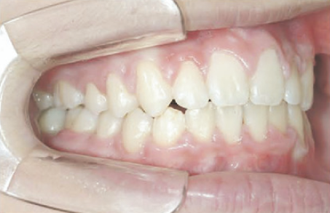
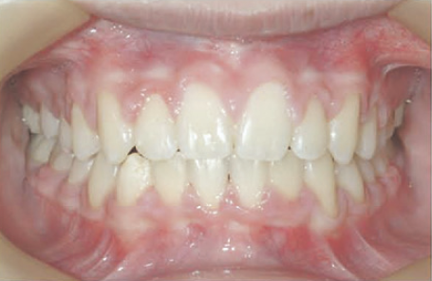
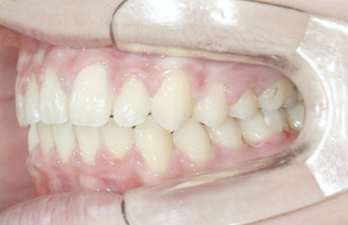
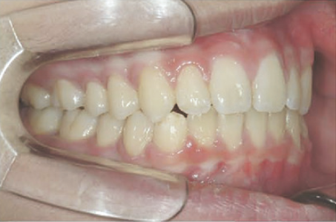
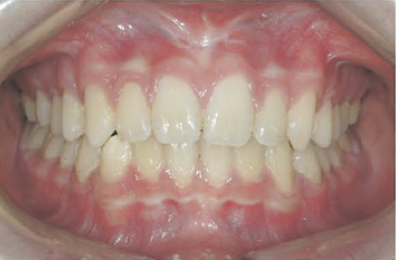
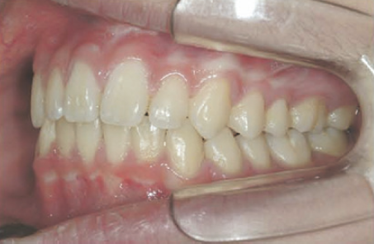

Slide 46
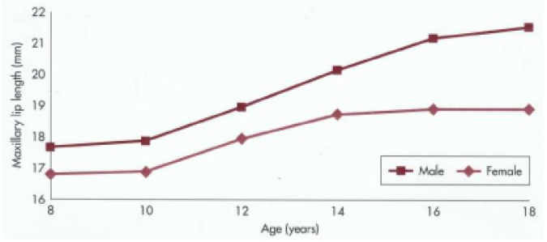
Gingival smile what the orthodontist must know : Lip maturation
Do not forgot the lip will go down during adolescence around 3 mm for the male and 2 mm for the female

Slide 47
Gingival smile what the orthodontist must know : Crown lengthening
Indication :
Every time that the anatomical crown is not fully apparent: delayed passive eruption
In relation to the gingival smile
When the incisal edges are in good postion in relation to the lower lip during smile display AND the anatomical crown is not fully apparent.

Slide 48
Gingival smile what the orthodontist must know : Crown lengthening
Back to basic
Dimensions and Relations of the Dentogingival Junction in Humans
Anthony W. Gargiulo, d.d.s., m.s., Frank. M. entz, d.d.s., ph.d., and balint ORBAN, m.d., d.d.s.
Journal of Periodontology 1961; 32: 261-267

Slide 49
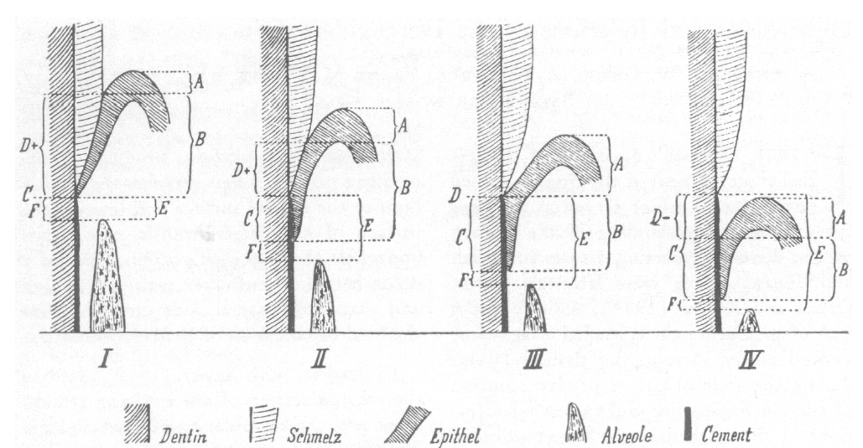
Gingival smile what the orthodontist must know : Crown lengthening
Study of the dentogingival junction on 30 human jaw
The author measured :
depth of the gingival sulcus
length of the attached epithelium
most apical point of the epithelial attachment from the cemento enamel junction
distance from the base of the sulcus to the cemento-enamel junction
distance of the cemento-enamel junction from the alveolar bone
distance from the most apical point of the epithelia attachment to the alveolar bone (connective tissue).

Slide 50
Gingival smile what the orthodontist must know : Crown lengthening
The distance to the base of the epithelial attachment to the crest of the alveolar bone to be constant with a mean of 1.07 mm
the epithelial attachment was more variable and averaged 0.97 mm
If you add 1 mm for the sulcus depth it mean that the border of the gingiva will be situated at 3 mm of the crest of the alveolar bone.
You cannot reduce this distance.

Slide 51
Gingival smile what the orthodontist must know : Crown lengthening
Treatment of Altered Passive Eruption: Periodontal Plastic surgery of the Dentogingival Junction
Roberto Rossi, Remo Benedetti, Regina Isabel Santos-Morales
The European Journal of Esthetic Dentistry. Volume 3. Number 3 2008 212-223

Slide 52
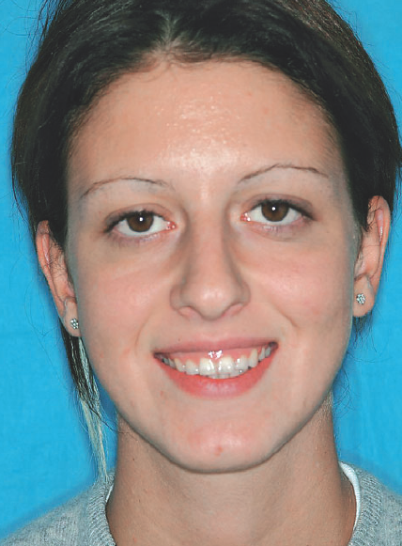
Gingival smile what the orthodontist must know : Crown lengthening
27 year old female
Consult for gummy smile and short clinical crown
The smile line and lips line are consonant
No lips incompetence

Slide 53
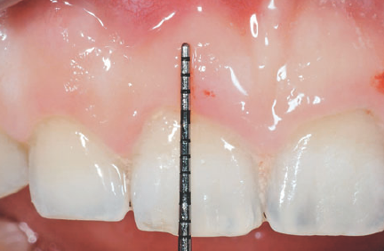
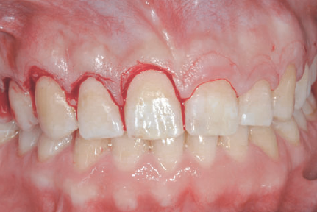
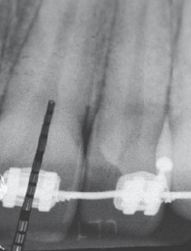
Gingival smile what the orthodontist must know : Crown lengthening
The lenght of the clinical crown was 8 mm
The length of the anatomical crown was the 12 mm
The alveolar crest was at the level of the CEJ
If only the removal of the gingiva at a level close to the CEJ was performed
A rebound of the gingiva to its initial level would occur

Slide 54
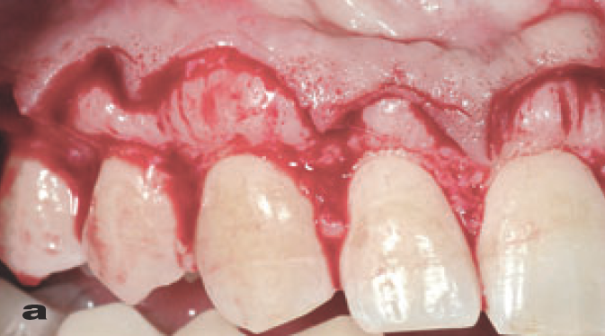
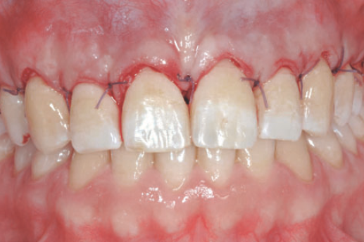
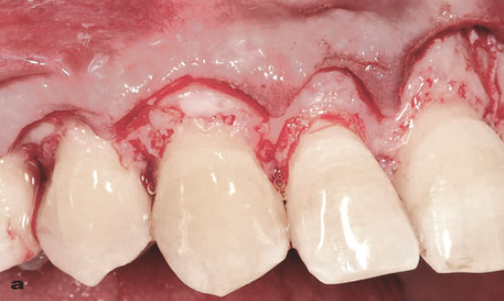
Gingival smile what the orthodontist must know : Crown lengthening
In this case the bone was remove to leave at least 2 mm of space between the alveolar crest and the CEJ

Slide 55

Gingival smile what the orthodontist must know : Crown lengthening

Slide 56
Gingival smile what the orthodontist must know : Botox
Botulinum toxin type A (Botox) for the neuromuscular correction of excessive gingival display on smiling (gummy smile)
Mario Polo
Am J Orthod Dentofacial Orthop
2008;133:195-203

Slide 57
Gingival smile what the orthodontist must know : Botox
The purpose of that pilot study was to determine whether injecting BTX-A at particular muscle sites could provide staticaly repeatible alternative therapy for gummy smiles caused by hypercontractibility or excessive muscle contraction
Hyperfunctional, or hypertonic, muscles are excessively active muscles with greater than normal contraction potential.

Slide 58
Gingival smile what the orthodontist must know : Botox
Material and method
This study’s inclusion criteria were excessive gingival display on smiling secondary to hyperfunctional upper lip elevator muscles
when etiology also included anoter factor it was treated first
at least 3.0-mm gingival display on unrestricted, nonposed, “full-blown” smiling
no vertical maxillary excess, as determined by lateral radiographic skull views and cephalometric measurements.
Patient with amyotrophic lateral sclerosis, motor neuropathy, myasthenia gravis, or Lambert-Eaton syndrome were excluded
pregnant women and the one not using contraceptive were excluded
Breast feeding women
Patient participating in a study of another drug or device
Patients using certain medications such as aminoglycosides, anticholinesterases, and other agents interfering with neuromuscular transmission;
A negative blood pregnancy test ( hCG test), performed 1 to 4 hours before injection was required for all female subjects of child-bearing age.
What you have to remember : Botox is safe really !!

Slide 59
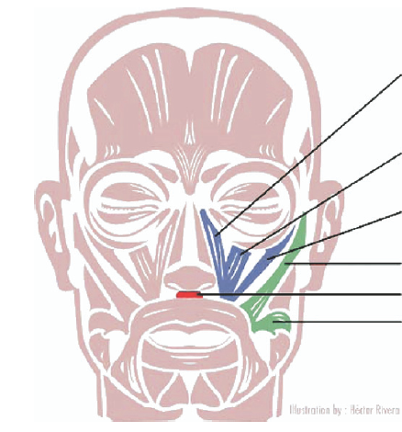
Gingival smile what the orthodontist must know : Botox
Levator labii superioris alaeque nasi muscle
Levator labii superioris muscle
Zygomaticus minor muscle
Zygomaticus major muscle
Depressor septi nasi muscle
Risorius muscle

Slide 60
Gingival smile what the orthodontist must know : Botox
BTX-A was diluted to 2.5 unit by 0.1ml
2.5 unit were injected:
in the overlapping points of the levator labii superioris alaeque nasi and levator labii superioris
and the overlapping points of the levator labii superioris and the zygomaticus minor

Slide 61
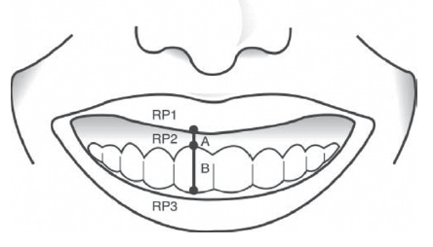
Gingival smile what the orthodontist must know : Botox
Material and method
30 Hispanic subject enter the study (29 female and 1 male)
Standardize picture were taken before injection, 2 weeks after injection and every 4 weeks for 24 weeks
Measurement were done using Photoshop
RP1: the lowest margin of the upper lip perpendicular and superior to the mid portion of the maxillary central incisor’s gingival margin
RP2: the maxillary central incisor’s gingival margin at its midpoint
RP3: the midpoint of the

Slide 62
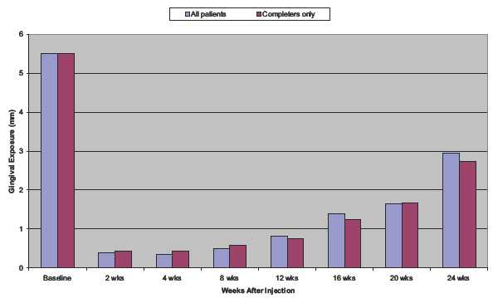
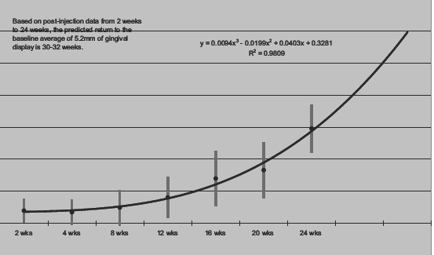
Gingival smile what the orthodontist must know : Botox
The average lip-drop at 2 weeks was 5.1 mm for 30 patients. Gingival display gradually
increased from 2 weeks postinjection through 24 weeks, but, at 24 weeks, average gingival display had notreturned to baseline values.
Based on predictions from a third-order polynomial equation, the baselineaverage of 5.2 mm would not be reached until 30 to 32 weeks postinjection
R² = 0.98

Slide 63
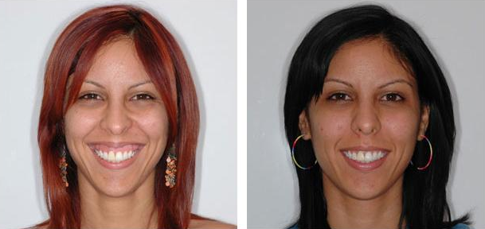
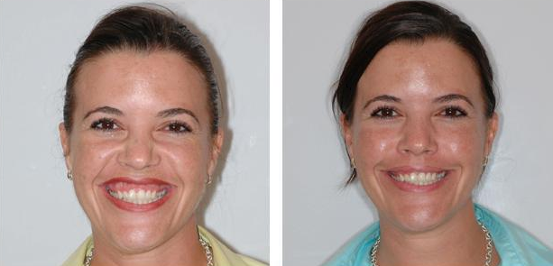


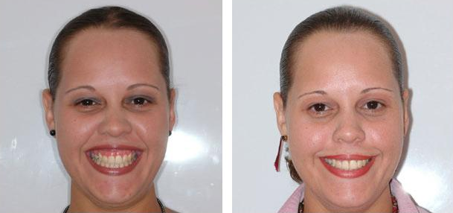

Gingival smile what the orthodontist must know : Botox

Slide 64
Gingival smile what the orthodontist must know : Botox
Critics
Letters to the editor
American Journal of Orthodontics and Dentofacial Orthopedics 2008 Volume 133, Number 6 P 782- 83
Joe Niamtu

Slide 65
Gingival smile what the orthodontist must know : Botox
This is the most comprehensive and scientifically based article that I have seen on smile esthetics related to gingival display in the literature, orthodontic or otherwise.
I have performed similar treatments for this condition for the past decade and have experimented with various injection sites to obtain results similar to Dr Polo’s.
Although I have before and after pictures that show the same results as Dr Polo’s, I believe there is a lot more than what meets the eye in a still picture.
Almost without exception, the patients I treated ended up with less gingival exposure, but .....

Slide 66
Gingival smile what the orthodontist must know : Botox
they also experienced unesthetic perioral animation
when observing them in normal, everyday oral function, they looked dysfunctional
This varied from slight changes in smile, pucker, and word pronunciation to a “stroke-like” expression in some phases of animation
One explanation can be that Dr Polo patient are mostly adolescent and young adults when the author patient were in the 35-60 zone, perhaps adolescent are less sensitive than adult to functional trouble
Any way the ratio of patient seeking retreatment has been low

Slide 67
Gingival smile what the orthodontist must know : Botox
An additional fault of this well-designed study method was the apparent fact that the patients knew what the treatment goal was: less gingival exposure when smiling.
I believe they could have an unconscious tendency to smile differently in the after photos.
Six of the 12 subjects are obviously recruiting upper facial muscular anatomy (squinting) in the preinjection photos but not in the postinjection pictures— evidenced by the lack of squint in the after pictures and the increased palpebral fissure
In my thinking, the only reliable means of controlling smile dynamics would be to accurately stimulate the individual muscles with electrical current (before and after treatment) with needle electrodes;

Slide 68
Gingival smile what the orthodontist must know : Botox
Finally, I want to add a note of caution for practitioners who read this article and think that changing a smile with several simple cutaneous injections of Botox can be done without complications.
Although Botox treatment in the upper face produces dramatic results with minimal complications, Botox injection in the mid and lower face can be hugely problematic in inexperienced hands.
A small amount of this extremely potent toxin in the wrong place can produce a horrific dysfunction that can last for 3 to 4 months.
I have seen patients from other offices with severe drooling, inability to pucker, grossly asymmetric smile, inability to annunciate certain words or sounds, and “stroke-like” animation because of misplacement or overdosage of Botox.
In the upper face, complications can include double vision and eyelid droop
in the midface, complications can include dysanimation
in the lower face and neck, there can be problems in speaking, swallowing, and holding the head up.
Having said this, no practitioner should inject this potent neurotoxin without proper training and the ability to manage possible related complications.

Slide 69
Gingival smile what the orthodontist must know : Botox
In his answer Dr Polo indicates that the animation of the patient before and after can be checked on the video on his web site
But only one video is available
Dr Polo explained that many patient seek retreatment but was not specific about the percentage
Dr Polo report that none of his patient reported any adverse effect and attributed the effect described by Dr Niamtu to possible differences in their protocol.

Slide 70
Gingival smile what the orthodontist must know : Botox
Gummy smile and botulinum toxin: A new approach based on the gingival exposure area
Rosemarie Mazzuco, MD,a and Do´ris Hexsel, MD
J Am Acad Dermatol 2010;63:1042-51

Slide 71
Gingival smile what the orthodontist must know : Botox
This article describes a new classification of GS into anterior, posterior, mixed, or asymmetric, based on the excessive contraction of specific muscle groups, resulting in different areas of excessive gingival display, and a resultant new approach to the treatment of GS with BT.
Depending on the serverity and the localisation of the Gingival smile the author vary the localization of injection and the quantity of botox injected

Slide 72


Gingival smile what the orthodontist must know : Botox
anterior GS, in which more than 3 mm of gum is exposed in the area between the canine teeth
involving the action of the levator labii superioris alaeque nasi (LLSAN)

Slide 73

Gingival smile what the orthodontist must know : Botox
posterior GS, in which more than 3 mm of gum is exposed posterior to the canines, with normal exposure (>3 mm) in the anterior region
involving the action of the zygomatic muscles

Slide 74

Gingival smile what the orthodontist must know : Botox
mixed GS, with excessive gum exposure in both the anterior and posterior region involving the action of a combination of two or more of the above muscles

Slide 75

Gingival smile what the orthodontist must know : Botox
asymmetric GS, with excessive or more apparent gum exposure on one side caused by asymmetric contraction of the LLSAN or zygomatic muscles

Slide 76
Thank you

